Slide 1
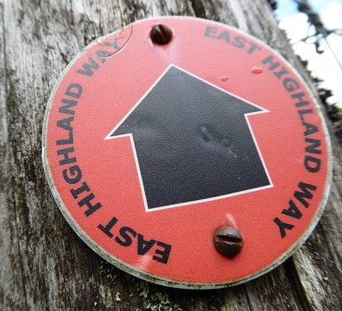
Waymarks
This Photo by Unknown author is licensed under CC BY-SA.

Slide 2
Dawning of the morning
And that, knowing the time, that now it is high time to awake out of sleep: for now is our salvation nearer than when we believed. The night is far spent, the day is at hand: let us therefore cast off the works of darkness, and let us put on the armour of light.
Rom 13:11-14

Slide 3
Then shall the kingdom of heaven be likened unto ten virgins, which took their lamps, and went forth to meet the bridegroom. And five of them were wise, and five were foolish. They that were foolish took their lamps, and took no oil with them: But the wise took oil in their vessels with their lamps...
This Photo by Unknown author is licensed under CC BY.

Slide 4
While the bridegroom tarried, they all slumbered and slept.

Slide 5
... And at midnight there was a cry made, Behold, the bridegroom cometh; go ye out to meet him.

Slide 6
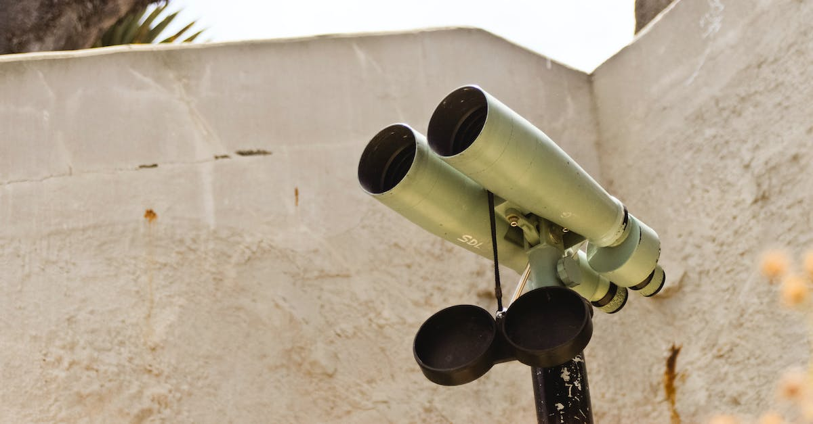
Watch therefore, for ye know neither the day nor the hour wherein the Son of man cometh. Matt 25:1-6, 13
Question;
Watch for What?

Slide 7
Waymarks;
/ (ˈweɪˌmɑːk) / noun. a symbol or signpost marking the route of a footpath.
Dictonary.com

Slide 8
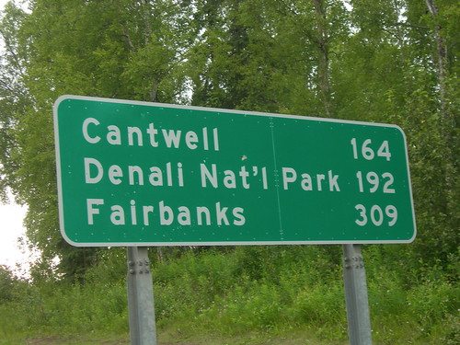
Do we have any Mileage signs?
How much further?
This Photo by Unknown author is licensed under CC BY-NC-ND.

Slide 9
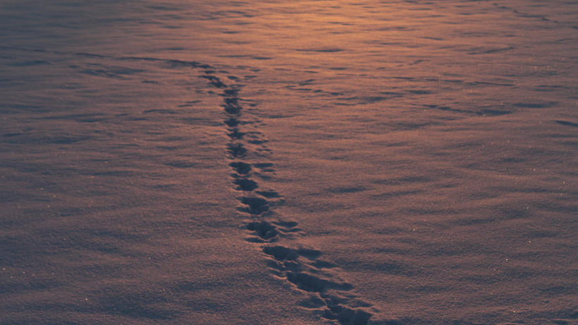
Waypoint 1:
Revelation 17
This Photo by Unknown author is licensed under CC BY-NC-ND.

Slide 10
Ten Kings that would arise and for one hour give their power and strength to the wicked people of this earth... Rev 17:12,13

Slide 11
The rise of National Populism;
Right-wing populism, also called national populism and right-wing nationalism, is a political ideology that combines right-wing politics and populist rhetoric and themes. Its rhetoric employs anti-elitist sentiments, opposition to the Establishment, and speaking [Governing] ... for the "common people".

Slide 12
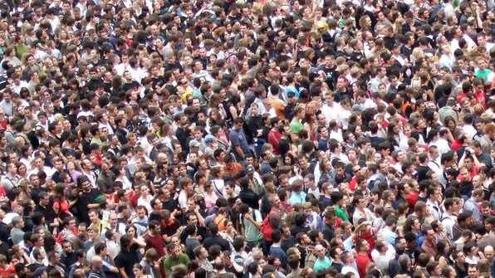
Headline; "National Populism sweeps the world"
Countries with Populist Political powers surging to power; A 9by no means complete) list:
This Photo by Unknown author is licensed under CC BY-SA-NC.

Slide 13
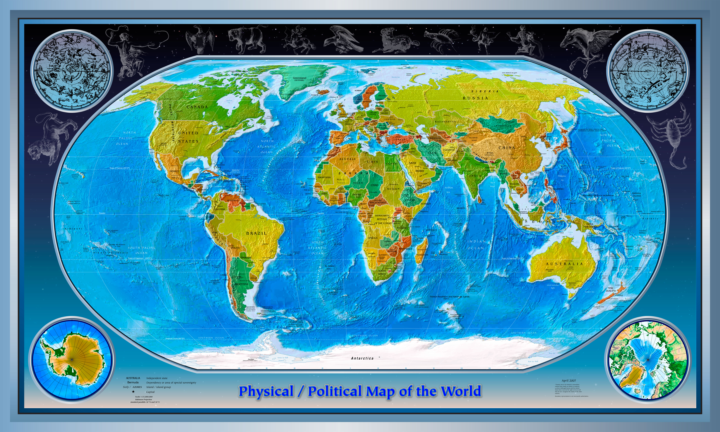
New zealand
Australia
Germany (AFD)
Netherlands (BBB)
Italy
France
Luxembourg
Canada
This Photo by Unknown author is licensed under CC BY-SA.

Slide 14
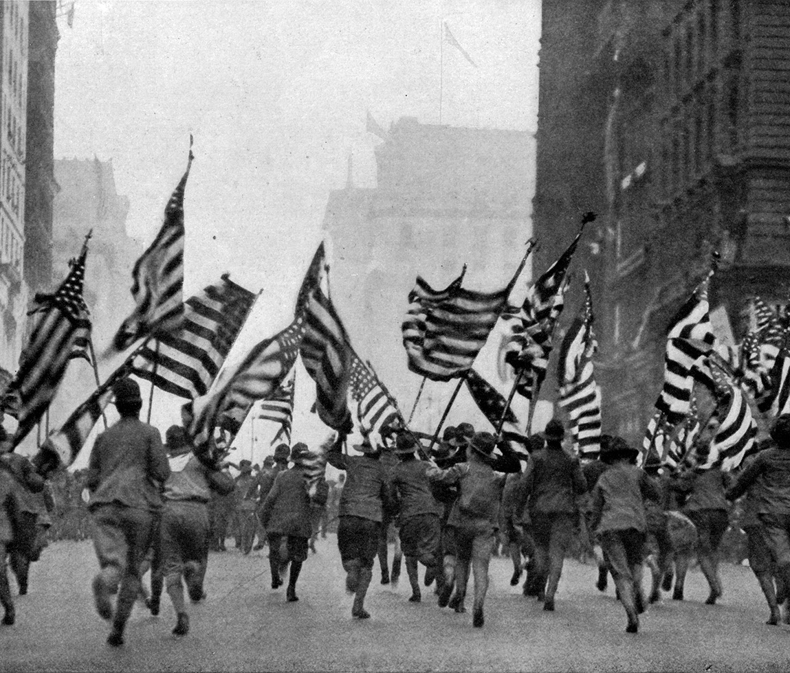
And....
The United States of America
This Photo by Unknown author is licensed under CC BY-SA.
This Photo by Unknown author is licensed under CC BY-NC.

Slide 15
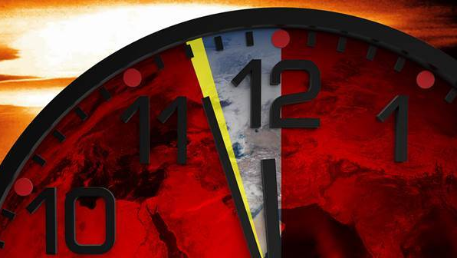
According to revelation 17, The Rise of populist political powers, signals the arrival of earths last hour!
This Photo by Unknown author is licensed under CC BY-NC.

Slide 16
Watch!
Take ye heed, watch and pray: for ye know not when the time is.
For the Son of Man is as a man taking a far journey, who left his house, and gave authority to his servants, and to every man his work, and commanded the porter to watch...

Slide 17
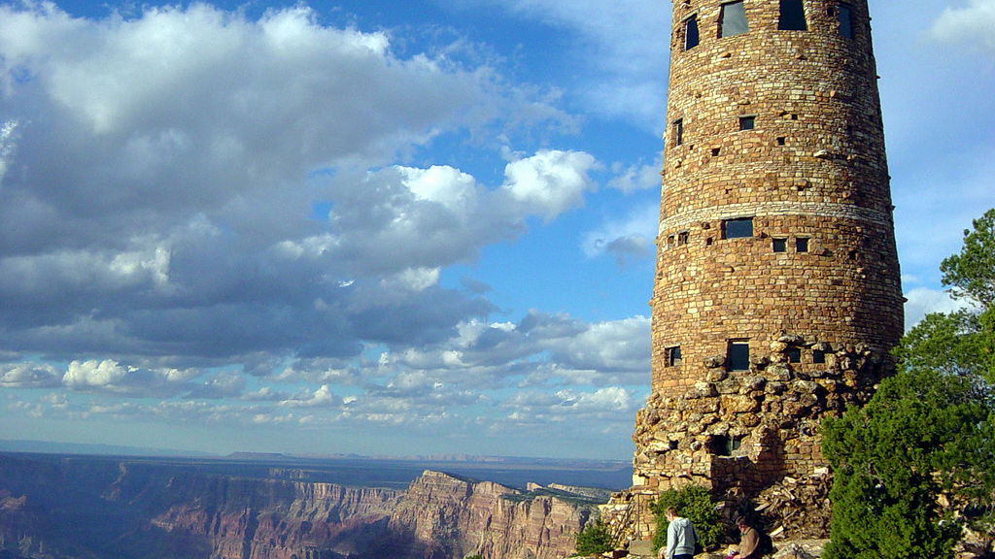
...Watch ye therefore: for ye know not when the master of the house cometh, at even, or at midnight, or at the cockcrowing, or in the morning:
Lest coming suddenly he find you sleeping.
And what I say unto you I say unto all, Watch
This Photo by Unknown author is licensed under CC BY.

Slide 18
Waypoint 2:
Daniel 11
This Photo by Unknown author is licensed under CC BY-NC-ND.

Slide 19
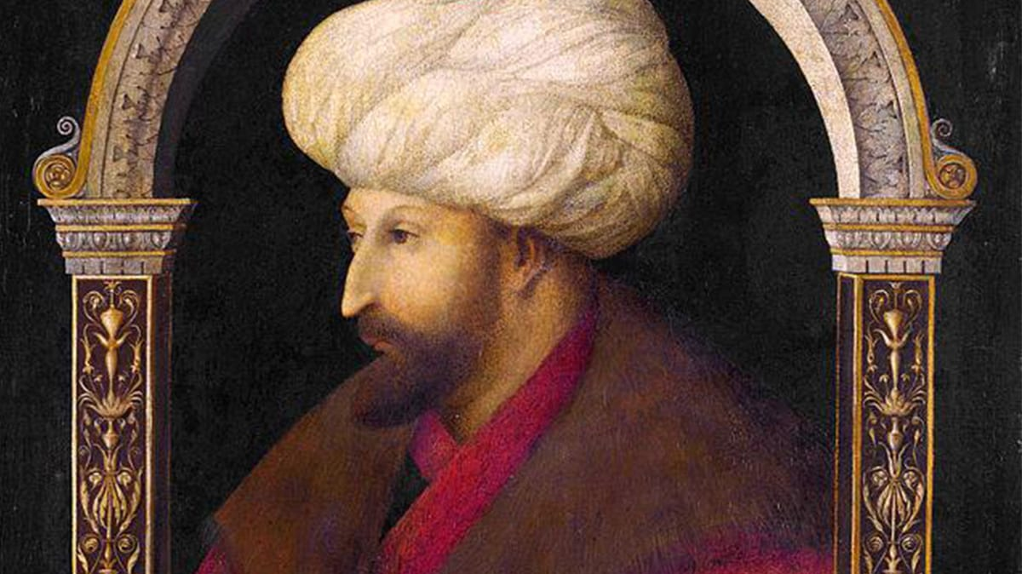
The king of the north
Daniel 11:45;
"And he shall plant the tabernacles of his palace between the seas in the glorious holy mountain; yet he shall come to his end, and none shall help him".
This Photo by Unknown author is licensed under CC BY-SA-NC.

Slide 20
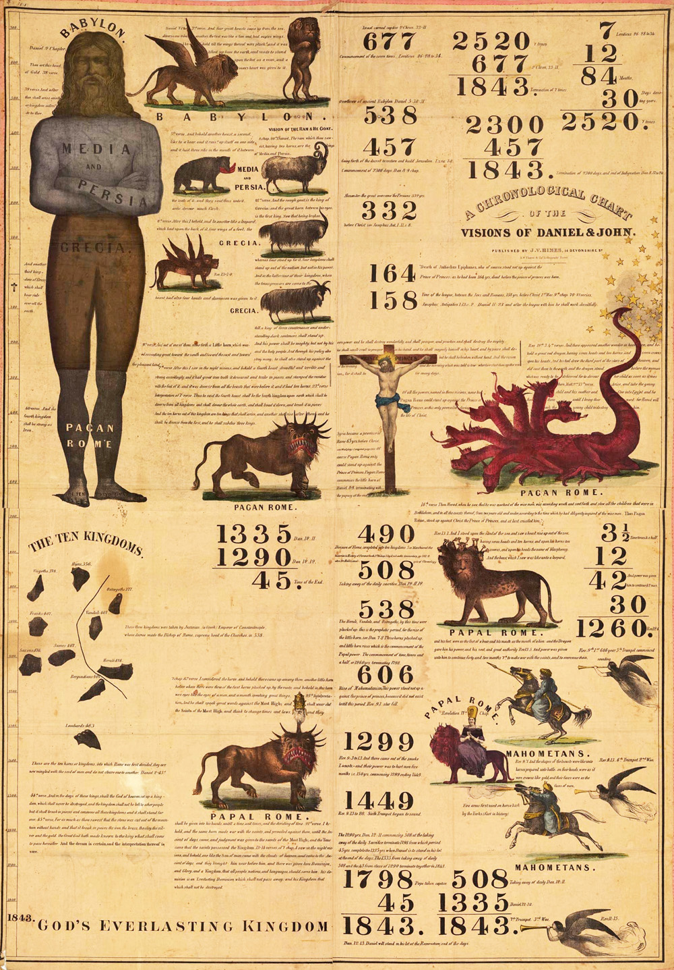
A historical continual prophecy...
Only this one verse in Daniel 11
remains to be fulfilled....
This Photo by Unknown author is licensed under CC BY-SA.

Slide 21
Watch...

Slide 22
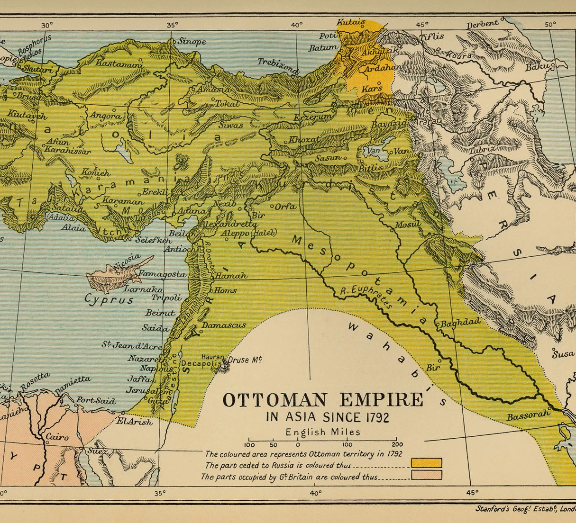
History & Geography...
This Photo by Unknown author is licensed under CC BY-SA.

Slide 23
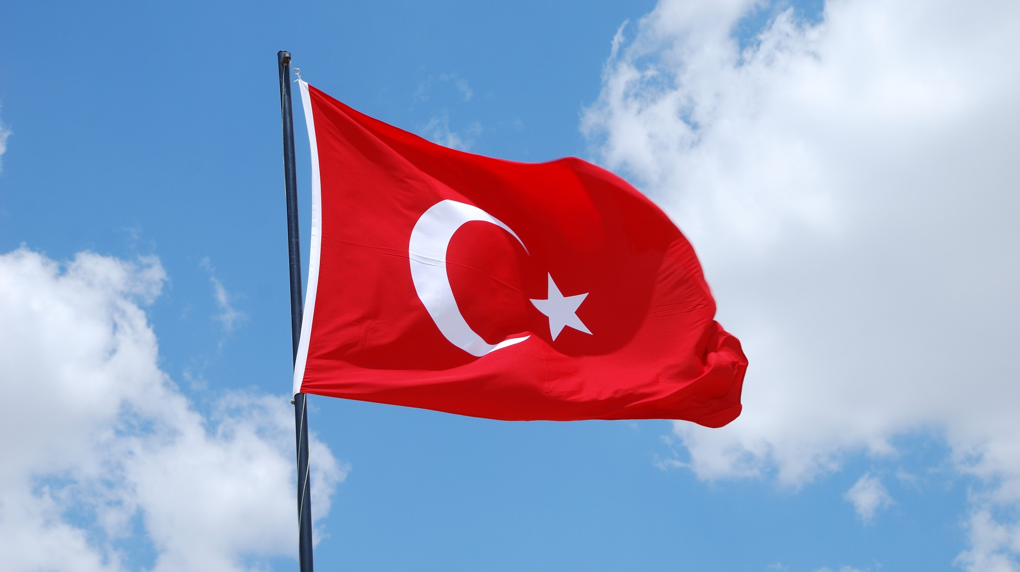
First history .....we don't have time...but a few words will have to do...

Slide 24
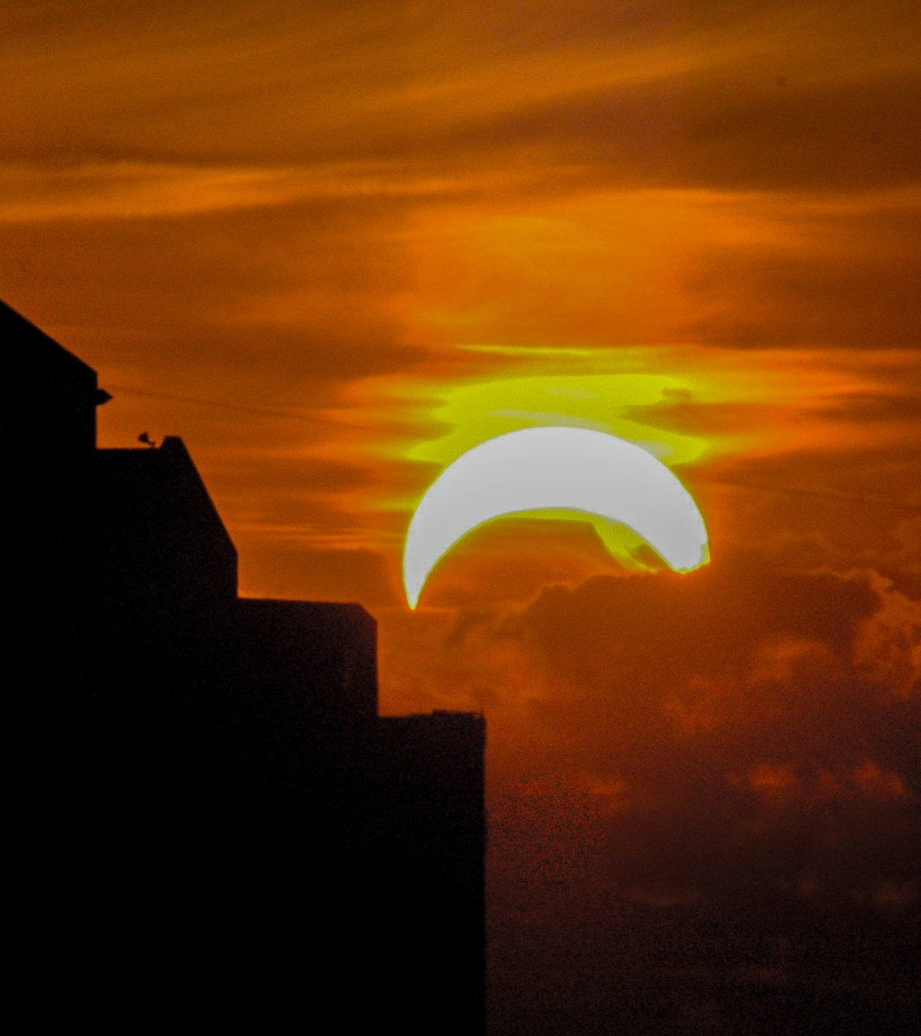
A prophecy unfulfilled....

Slide 25
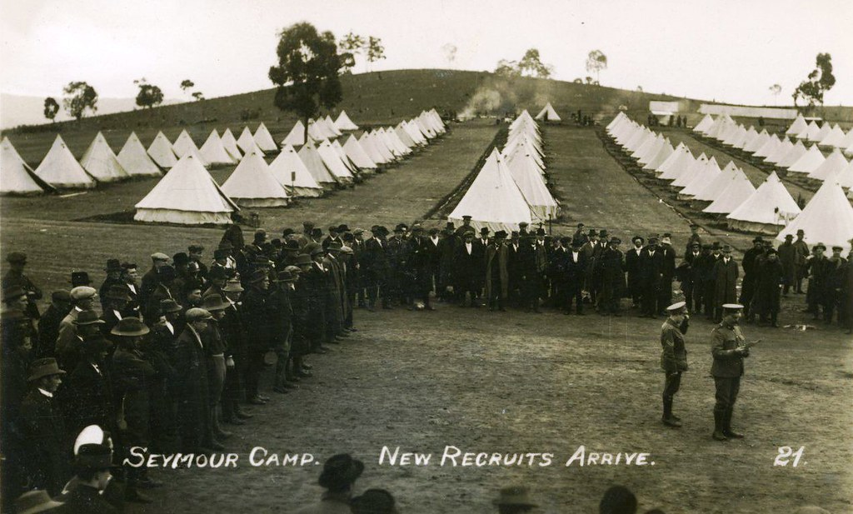
...And he shall plant the tabernacles of his palace between the seas in the glorious holy mountain; yet he shall come to his end, and none shall help him. Daniel 11:45

Slide 26
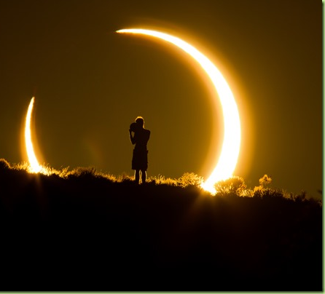
A prophecy about to be fulfilled?
This Photo by Unknown author is licensed under CC BY-SA-NC.

Slide 27
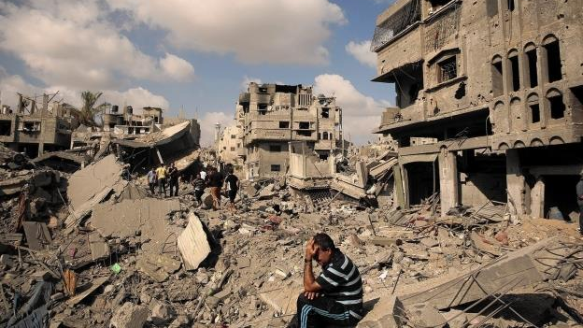
Israeli and Hezbollah war
This Photo by Unknown author is licensed under CC BY.

Slide 28
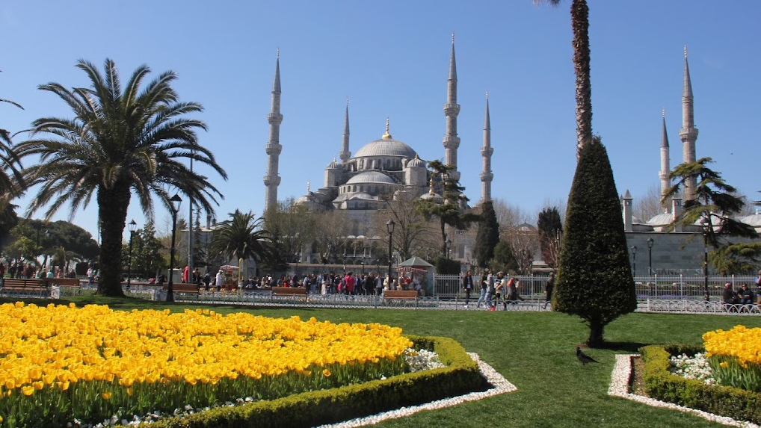
The successor of the Ottoman Turkish empire
...Modern Day Turkey
This Photo by Unknown author is licensed under CC BY-NC.

Slide 29
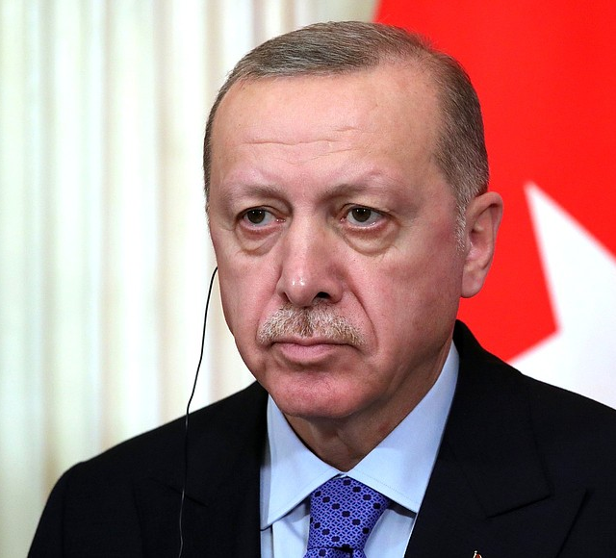
Recep Tayyip Erdoğan
Prime Minister
of Turkey
This Photo by Unknown author is licensed under CC BY.

Slide 30
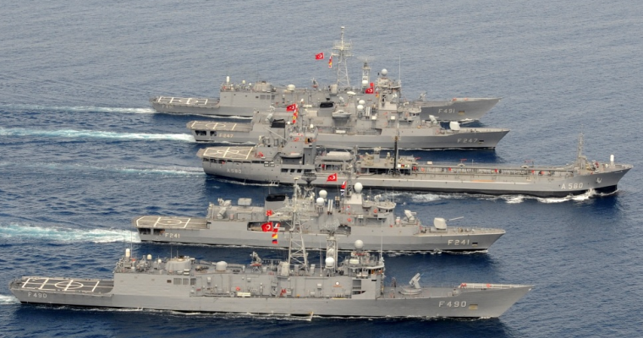
Turkeys' position on the war in Israel...
Turkey is busy trying to form an alliance of Muslem states to help the Palestinians
At the Turkey Africa Bussiness and Economic Forum, Erdogan stated that Turkey will support the Palestinian people.
It has dispatched it's navy and soldiers to Palestine!
This Photo by Unknown author is licensed under CC BY.

Slide 31
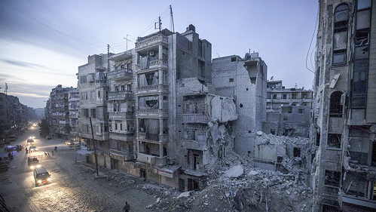
Erdogans' statement regarding his plans after the hospital attack....
"The attack on the hospital where women, children and innocent civilians are treated, is the latest example of Israeli attacks that lack the most basic human values. I call on all humanity to take action to stop this unprecedented brutality in Gaza...
This Photo by Unknown author is licensed under CC BY.

Slide 32
...If not, we [Turkey] will!"
This Photo by Unknown author is licensed under CC BY-SA-NC.

Slide 33
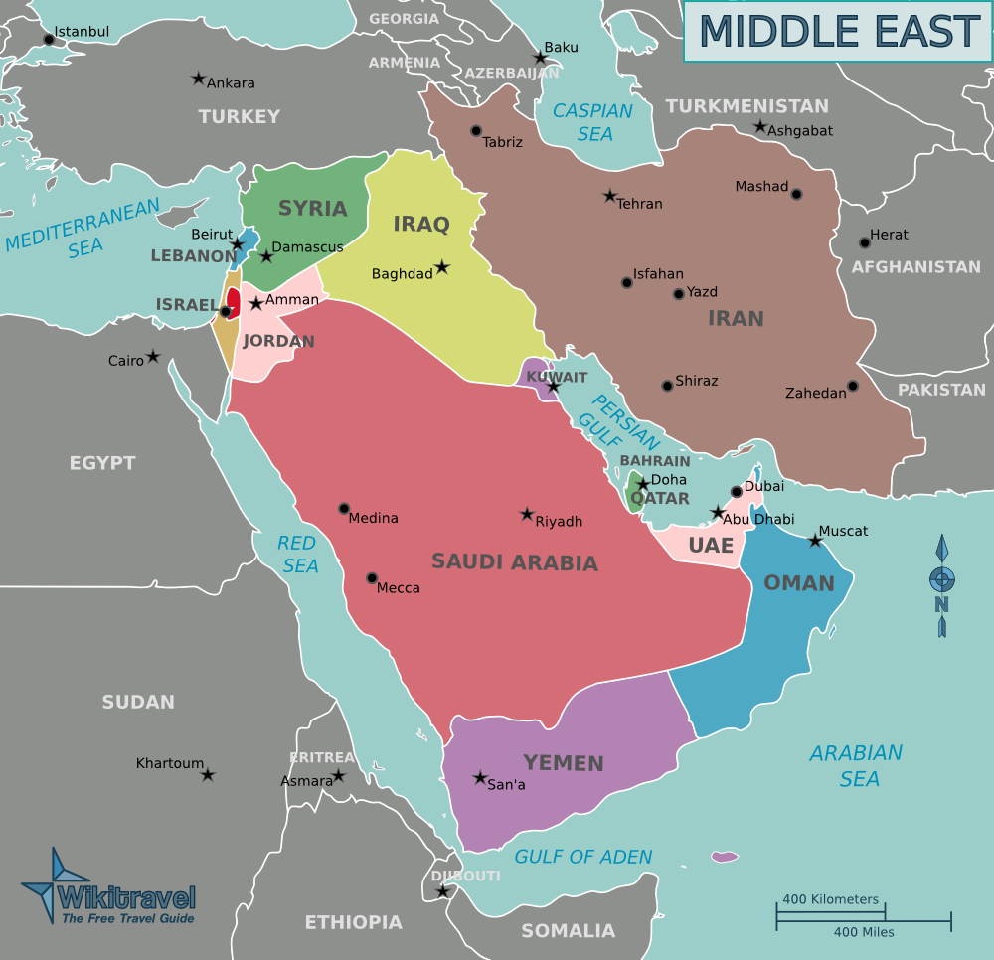
...& Geography
This Photo by Unknown author is licensed under CC BY-SA.

Slide 34
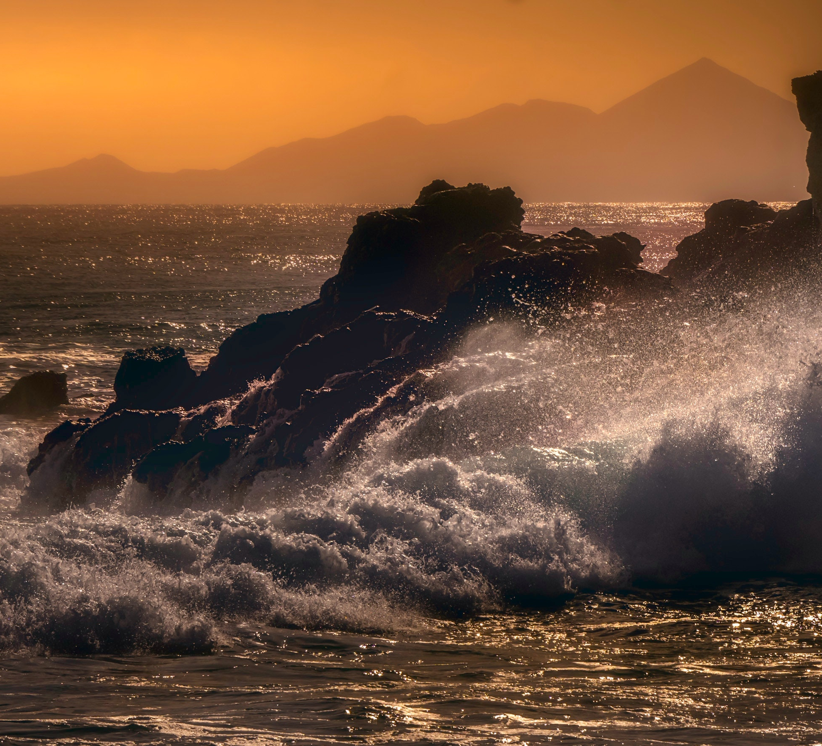
And he shall plant the tabernacles of his palace between the seas in the glorious holy mountain; yet he shall come to his end, and none shall help him.

Slide 35
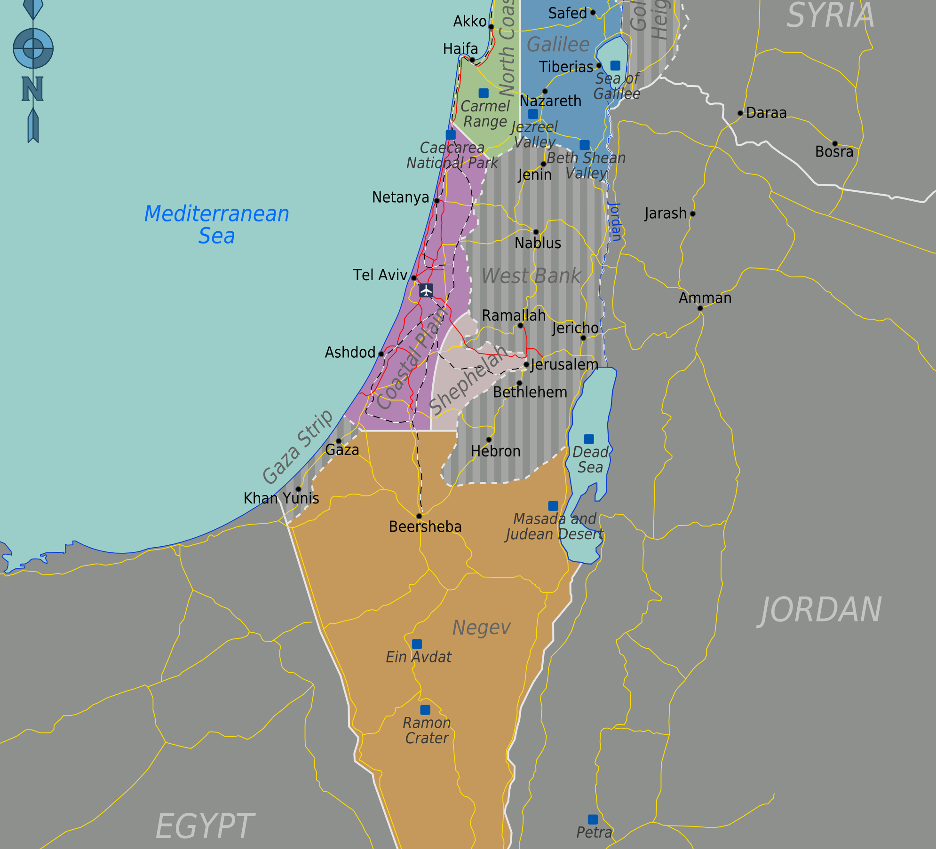
"Between the seas and the glorious Holy mountain..."
This Photo by Unknown author is licensed under CC BY-SA.

Slide 36
Seas...
Hebrew H3220 - יָם - Part of Speech:
Noun Masculine
Definition:
1. sea
a. Mediterranean Sea [!]

Slide 37
"Between the seas and the glorious Holy mountain..."
This Photo by Unknown author is licensed under CC BY-SA.

Slide 38
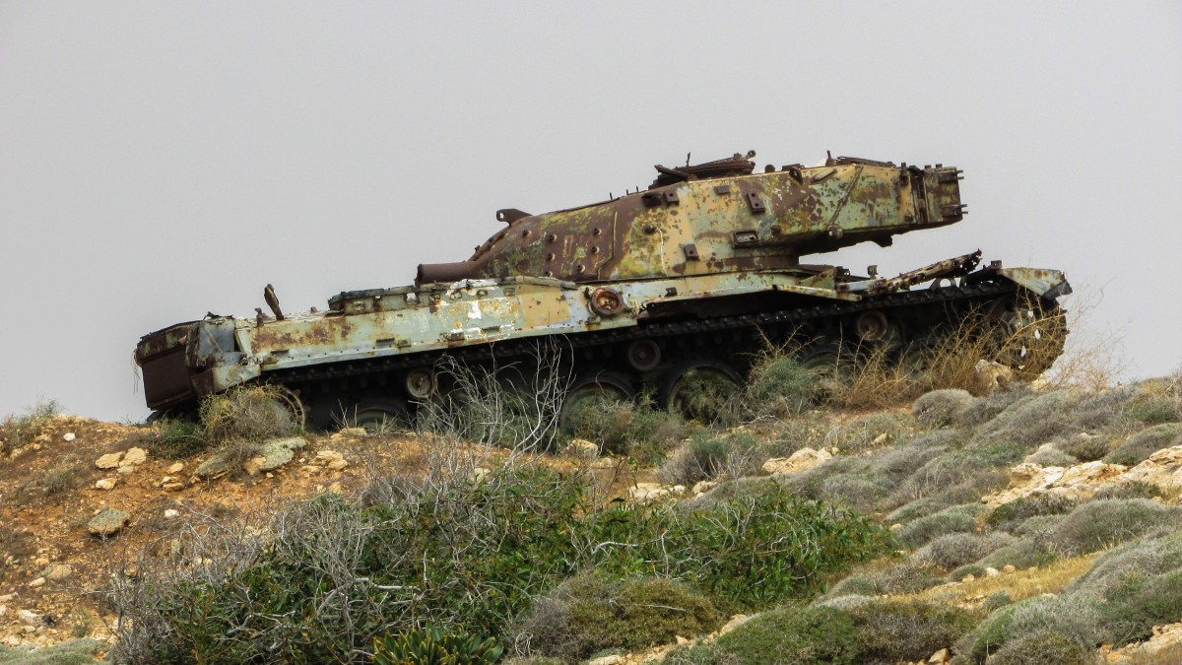
…"but he shall come to his end, and none shall help him"

Slide 39
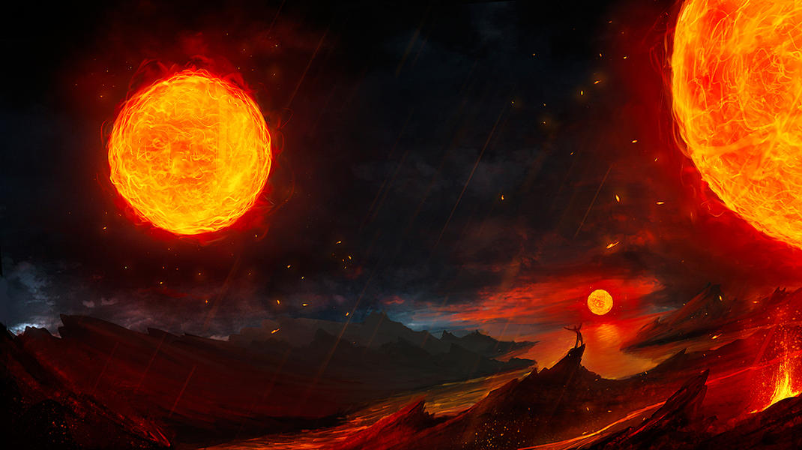
Daniel 12
The end of Grace for this world
This Photo by Unknown author is licensed under CC BY-NC-ND.

Slide 40
….Wherefore we receiving a kingdom which cannot be moved, let us have grace, whereby we may serve God acceptably with reverence and godly fear:
For our God is a consuming fire.
Hebrews 12:28,29
This Photo by Unknown author is licensed under CC BY.

Slide 41
Watch ye therefore, and pray always, that ye may be accounted worthy to escape all these things that shall come to pass, and to stand before the Son of man.
Luke 21:36
This Photo by Unknown author is licensed under CC BY-SA-NC.

