Slide 1
Revelation 17:3
“So he carried me away in the Spirit into the wilderness. And I saw a woman sitting on a scarlet beast which was full of names of blasphemy, having seven heads and ten horns.”

Slide 2
Revelation 17:12, 13.
The ten horns which you saw are ten kings who have received no kingdom as yet, but they receive authority for one hour as kings with the beast. ¹³ These are of one mind, and they will give their power and authority to the beast. ¹⁴ These will make war with the Lamb, and the Lamb will overcome them, for He is Lord of lords and King of kings; and those who are with Him are called, chosen, and faithful."

Slide 3
Revelation 19:19
“And I saw the beast, the kings of the earth, and their armies, gathered together to make war against Him who sat on the horse and against His army.”

Slide 4
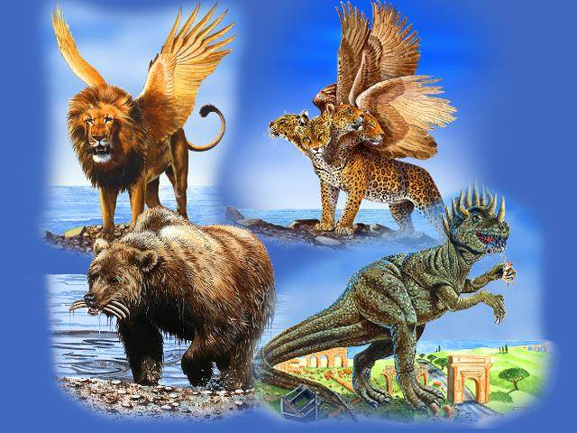

Slide 5
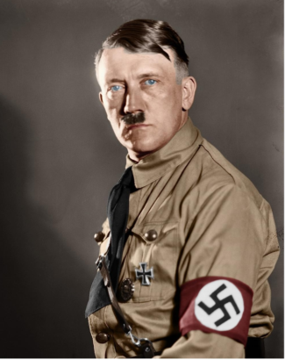
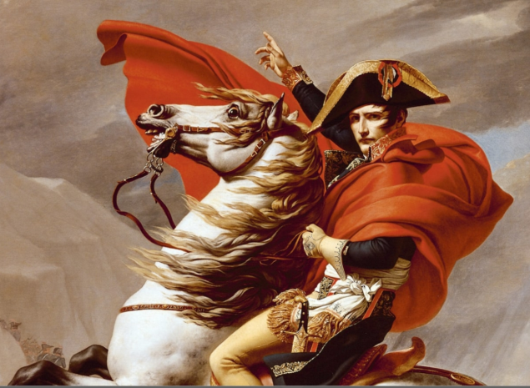

Slide 6
One World Government

Slide 7
Leaders of the World Coming Together

Slide 8
HISTORY OF WORLD GOVERNMENT

Slide 9
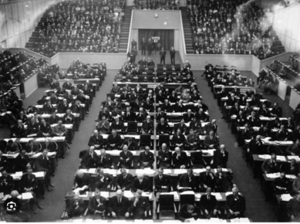
League of Nations (LoN) -- an intergovernmental organization founded as a result of the Treaty of Versailles in 1919–1920 after WW1.

Slide 10
United Nations
Membership of the United Nations organization is reserved for states, not individuals. (Established in 1944)
Not a legislative body and is thus limited to a mostly advisory role.
Purpose is to foster cooperation between existing national governments rather than exert authority over them.
Within the UN. -League of Democratic Nations which supports a federation of nations

Slide 11
THE GREAT RESET

Slide 12
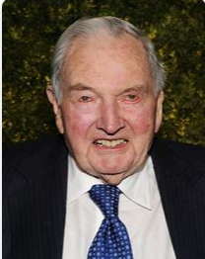
David Rockefeller(Founder Of The Trilateral Commission) said, “We are on the verge of a global transformation. All we need is the right major crisis and the nations will accept the New World Order…. WEF - chairman Klaus Schwab – sought world unity for decades –-

Slide 13
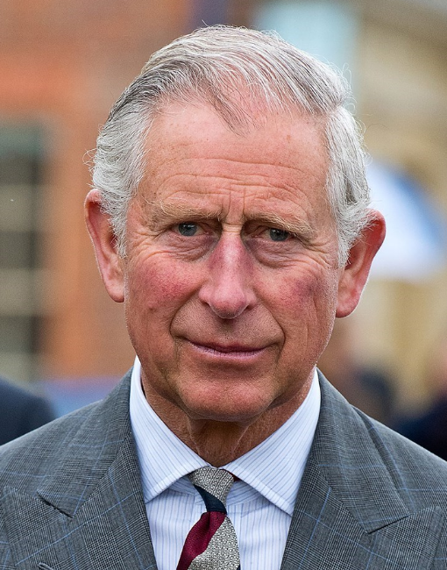
THE GREAT RESET - introduced by King Charles III before coronation
Great Reset Plan - June 2020. - global capitalism should be transformed so that corporations no longer focus solely on serving shareholders but become custodians of society by creating value for ‘stakeholders’ (society). - global governance.
It would have been the WEF Theme in 2021 - in Switzerland

Slide 14
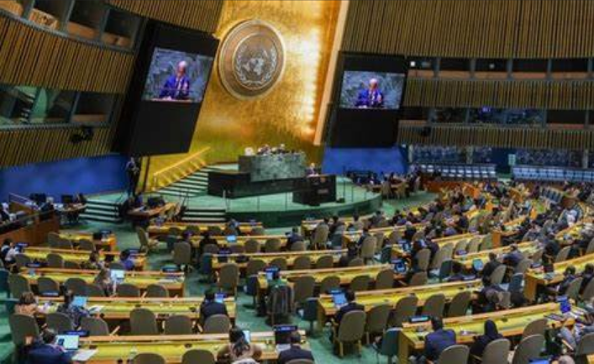
A UNITARY WORLD GOVERNMENT would consist of a single, central government body with supreme sovereignty. While administrative subdivisions might exist, their powers are delegated by the central government. (Wikipedia)

Slide 15
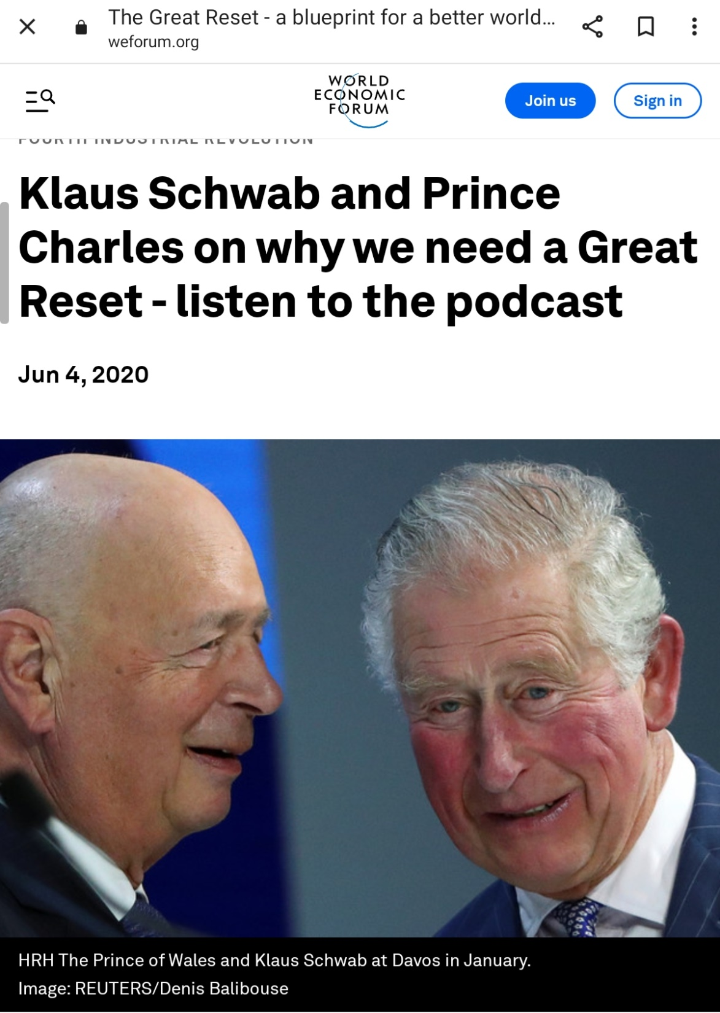
The Great Reset
King Charles III
King Charles major objective according to his first speech as king – to combat global warming

Slide 17
“The changes we have already seen in response to COVID-19 prove that a reset of our economic and social foundations is possible.
This is our best chance to instigate stakeholder capitalism - and here's how it can be achieved.

Slide 18
To achieve a better outcome, the world must act jointly and swiftly to revamp all aspects of our societies and economies, from education to social contracts and working conditions. Every country, from the United States to China, must participate, and every industry, from oil and gas to tech, must be transformed. In short, we need a “Great Reset” of capitalism.”
Klaus Shwab

Slide 19
WORLD FEDERALISM (or global federalism) Ideology
A federal world government.
Democratic ? What does that Mean?
CPUSA – wants democracy worldwide
Like China & Russia?
World Federation - would have Authority on Global Issues
Members - would retain authority over local and national issues.

Slide 20
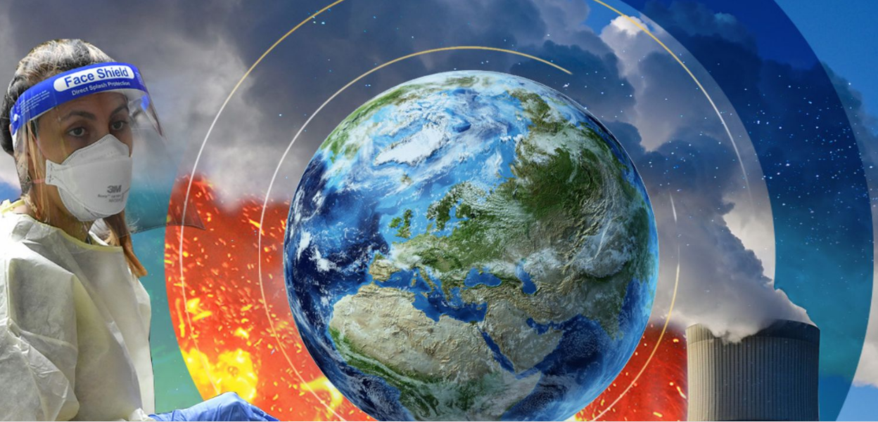
Reasons for Control:
Climate Collapse
Poverty – Food , redistribution of wealth
Control Internet Misinformation & Disinformation
Nuclear War, - Recent efforts to prohibit nuclear weapons, such as the Treaty on the Prohibition of Nuclear Weapons (TPNW) have been rejected

Slide 21
Reasons for Control:
In Upcoming UN Summit --- (Peace Activists) will discuss:
Nuclear risk-reduction and disarmament
WFM initiatives use common security approaches to replace reliance on nuclear -- a nuclear-weapon-free world (by UN)

Slide 22
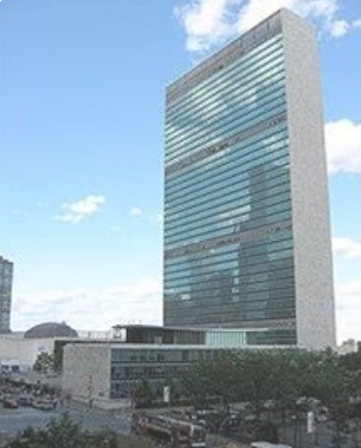
Proposals for the Establishment of a World Federation:
Reform of the UN and existing international institutions:
Incremental changes of the UN, for example through the inclusion of an elected UN Parliament
Within the UN.-- League of Democratic Nations which supports a federation of nations

Slide 23
Proposals for the Establishment of a World Federation:
Direct reform of the UN Charter,
Strengthening and democratization of existing global institutions, such as the World Trade Organization (WTO).
Establish an Earth Constitution

Slide 24
(Wikipedia)
“The Earth Constitution, drafted by international legal experts in 1968 and finalized in 1991, outlines a detailed plan for a world federalist government and is promoted today by the Earth Constitution Institute (ECI) and the World Constitution and Parliament Association (WCPA

Slide 25
Problems with Establishing a World Government
Powers seeking world domination – US , Russia, China, Islam
Requires extraordinary amounts of cooperation, coordination, international trust
Economic competition – Countries tax policies, Production and sale, distribution of wealth
Social Media – inability to control propaganda

Slide 26
Accusations Concerning Disinformation -
by the World Economic Forum
Governments are using Fact Checking Organizations to find people spreading “disinformation”.
Accusations Concerning Disinformation on:
Climate Change
Vaccinations
Abortion

Slide 27
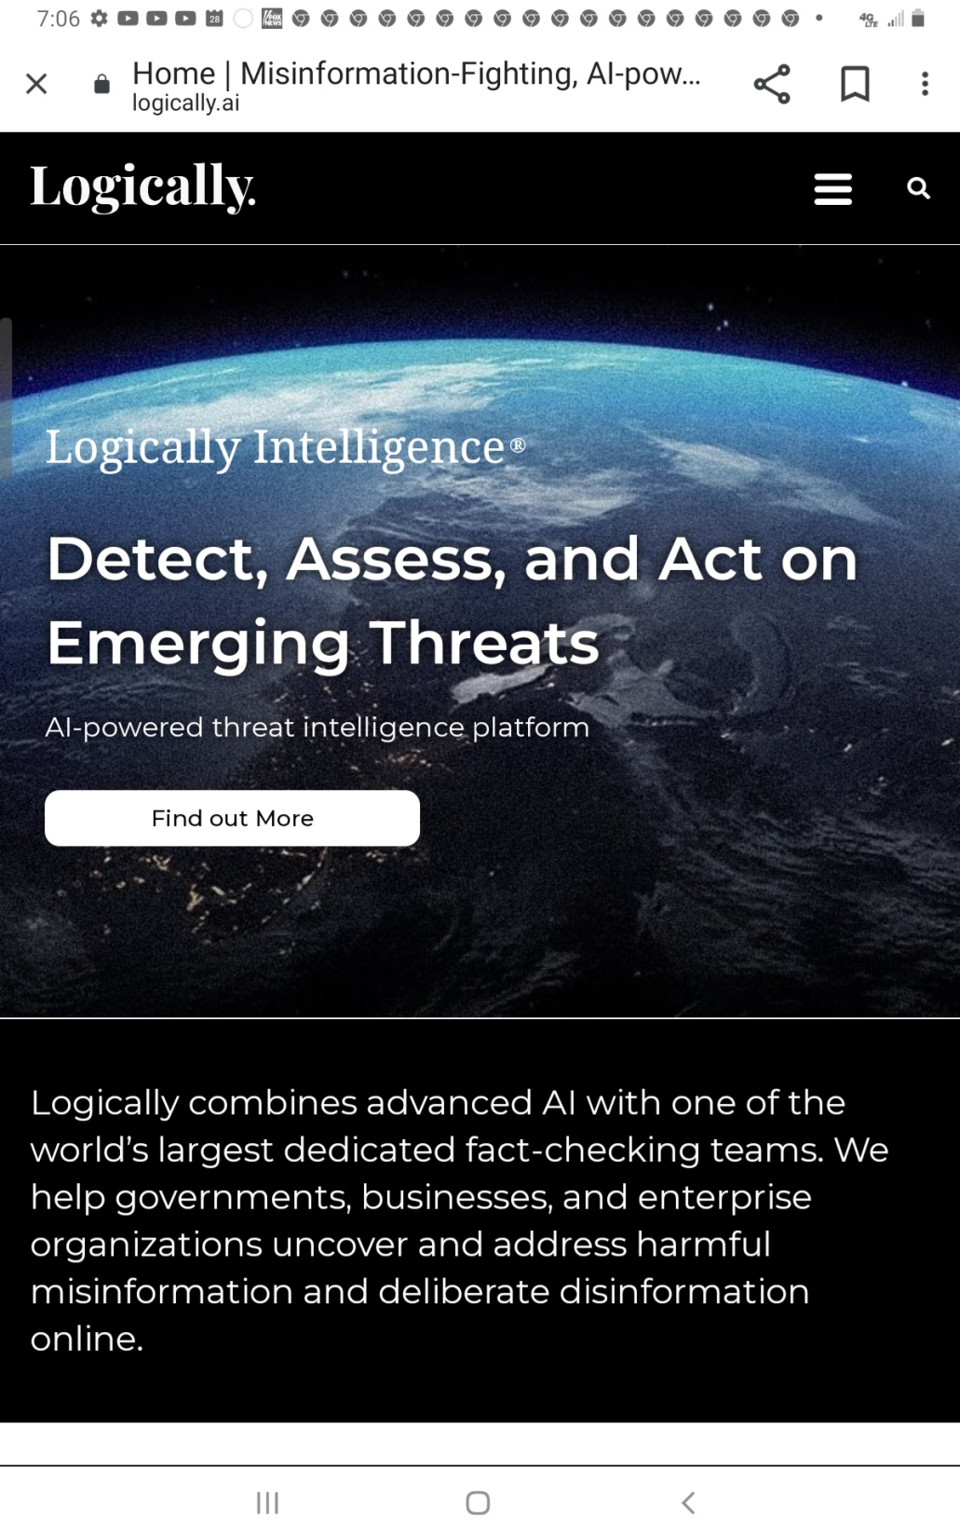
Supported by TicTok

Slide 29
There are nearly 50 organizations worldwide in favor of World Federalism.

Slide 30
Americas
Organization Abbreviation Headquarters Country Founded
The Streit Council, Inc. (formerly Federal Union, Inc.)SC Washington, D.C. USA 1939
Democracia Global DG Buenos Aires Argentina
Citizens for Global Solutions CGS Washington, D.C. USA 2003
Democratic World Federalists DWF San Francisco USA 2004
Centro Mexicano de Responsibilidad Global CEMERG Mexico
Center for Development of International Law New York USA
Institute for Global Leadership Worcester USA 2001
Workable World Trust St. Paul USA 2014
Coalition for the International Criminal Court CICC New York USA 1995
International Coalition for the Responsibility to Protect New York USA 2008
The World Parliament WP Radford USA
World Constitution and Parliament Association WCPA Independence, VA USA 1958
Vote World Parliament Shawville Canada 2004
World Federalist Movement/Institute for Global Policy WFM New York USA 1947
World Federalist Movement Canada WFMC Ottawa Canada 1951
World Federalist Movement Toronto Chapter Toronto Canada
World Service Authority Washington, D.C. USA 1953
Young World Federalists YWF West Palm Beach USA 2019
Earth Constitution Institute ECI Independence, VA USA
United World UW United States USA 2020

Slide 32
ENCYCLICAL LETTER FRATELLI TUTTI OF THE HOLY FATHER FRANCIS ON FRATERNITY AND SOCIAL FRIENDSHIP
Pope Francis calls for:
Single global authority with real teeth to prevent any nation or any small group of nations from having too much power. There should be the standardization of law worldwide.

Slide 33
Pope Francis calls for:
Single global authority with real teeth to prevent any nation or any small group of nations from having too much power. There should be the standardization of law worldwide.
Fight Poverty & Hunger,
Equal pay for workers
Fight Global Warming
Fight Pandemics

Slide 34
Pope Francis calls for:
Defend human rights
Do away with national borders
Stop Racism
Fight the Greed of Capitalism
Women’s Rights
Stop religious persecution
There should be global socialism

Slide 35
“ I would also note the need for a reform of “the United Nations Organization, and likewise of economic institutions and international finance, so that the concept of the family of nations can acquire real teeth”.

Slide 36
“The media can help us greatly in this, especially nowadays, when the networks of human communication have made unprecedented advances.”…” we cannot accept “a digital world designed to exploit our weaknesses and bring out the worst in people”.

Slide 37
“it is essential to devise stronger and more efficiently organized international institutions, with functionaries who are appointed fairly by agreement among national governments, and empowered to impose sanctions”.

Slide 38
“For these reasons, the Church, while respecting the autonomy of political life, does not restrict her mission to the private sphere. On the contrary, “she cannot and must not remain on the sidelines” in the building of a better world…
“Wherever the councils of nations come together to establish the rights and duties of man, we are honored to be permitted to take our place among them”.

Slide 39
Bible Predictions of One World Government

Slide 40
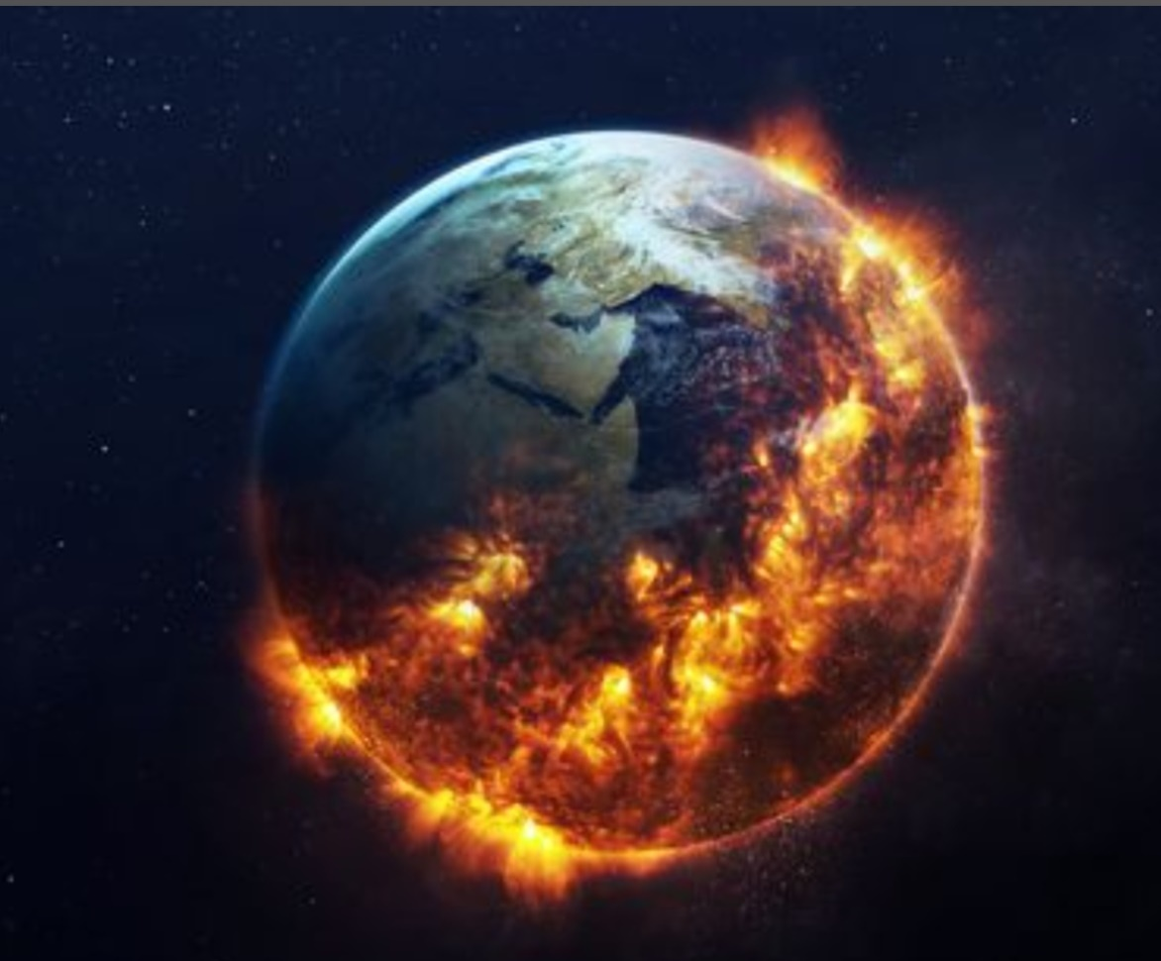
Revelation 16:14
“..which go out to the kings of the earth and of the whole world, to gather them to the battle of that great day of God Almighty.”

Slide 41
Revelation 12:17
“And the dragon was enraged with the woman, and he went to make war with the rest of her offspring, who keep the commandments of God and have the testimony of Jesus Christ.”

Slide 42
^{Revelation 17:16} “And the ten horns which you saw on the beast, these will hate the harlot, make her desolate and naked, eat her flesh and burn her with fire. ¹⁷“For God has put it into their hearts to fulfill His purpose, to be of one mind, and to give their kingdom to the beast, until the words of God are fulfilled.

Slide 43
Ps 91:2 “I will say of the Lord, “He is my refuge and my fortress; My God, in Him I will trust…”
⁴ He shall cover you with His feathers,
And under His wings you shall take refuge; His truth shall be your shield and buckler.
⁵ You shall not be afraid of the terror by night, Nor of the arrow that flies by day,
6 Nor of the pestilence that walks in darkness, Nor of the destruction that lays waste at noonday….

Slide 44
⁷ A thousand may fall at your side,
And ten thousand at your right hand;
But it shall not come near you.
⁸ Only with your eyes shall you look,
And see the reward of the wicked.
⁹ Because you have made the Lord, who is my refuge,
Even the Most High, your dwelling place,
¹⁰ No evil shall befall you,
Nor shall any plague come near your dwelling;

Slide 45
One World Government
Prophesied

Slide 46
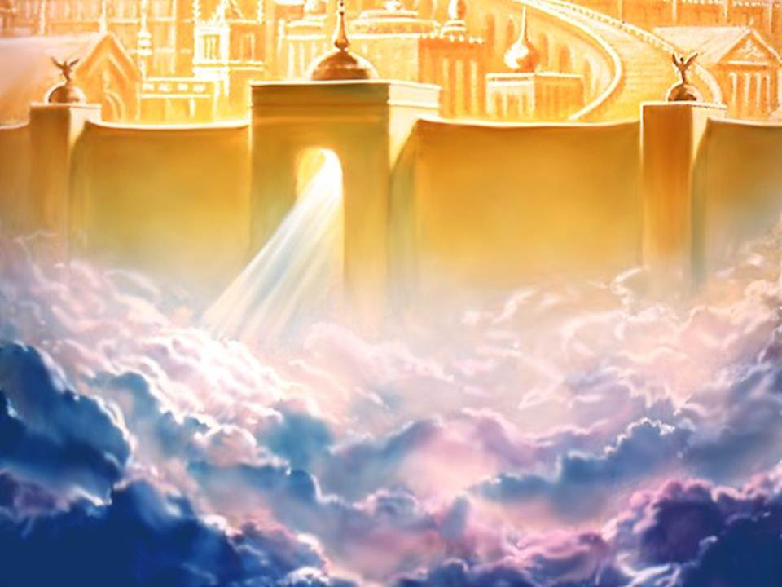
¹Now I saw a new heaven and a new earth, for the first heaven and the first earth had passed away. Also there was no more sea. ²Then I, John, saw the holy city, New Jerusalem, coming down out of heaven from God, prepared as a bride adorned for her husband.
Revelation 21

Slide 47
³And I heard a loud voice from heaven saying, “Behold, the tabernacle of God is with men, and He will dwell with them, and they shall be His people. God Himself will be with them and be their God.
Revelation 21

Slide 48
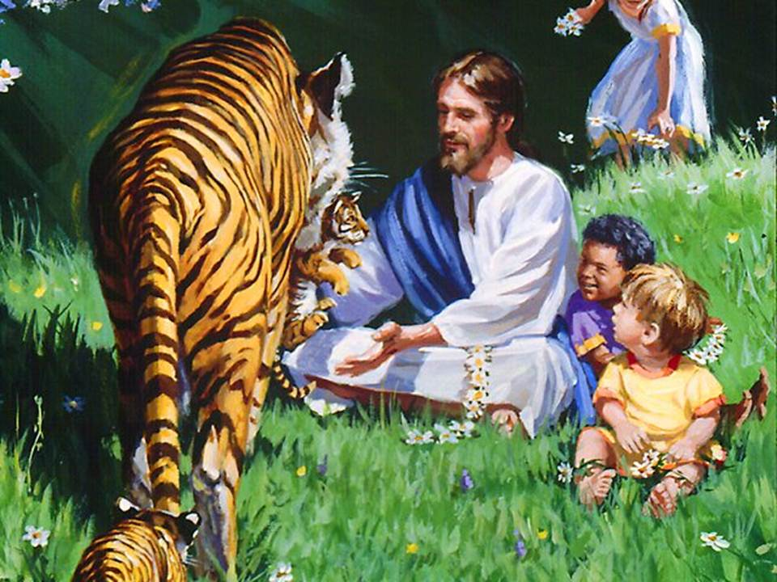
²⁴And the nations of those who are saved shall walk in its light, and the kings of the earth bring their glory and honor into it. ²⁵Its gates shall not be shut at all by day (there shall be no night there). ²⁶And they shall bring the glory and the honor of the nations into it.
Revelation 21

Slide 49
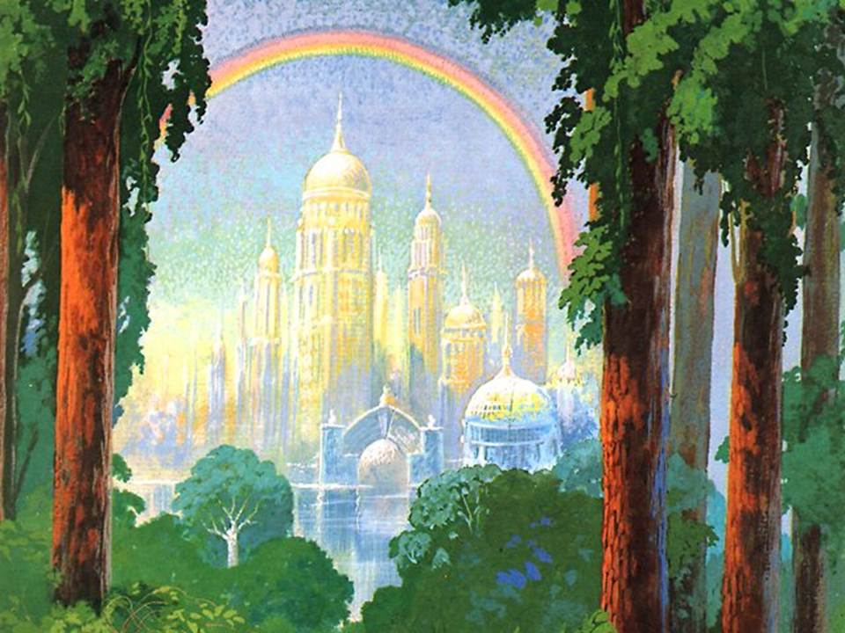
Moreover the light of the moon will be as the light of the sun, And the light of the sun will be sevenfold,
As the light of seven days, In the day that the Lord binds up the bruise of His people And heals the stroke of their wound.
Is 30:26

Slide 50
^{Ps 22:27:28} All the ends of the world
Shall remember and turn to the Lord,
And all the families of the nations
Shall worship before You.
²⁸ For the kingdom is the Lord’s,
And He rules over the nations.

Slide 51
Is 45:23 “Look to Me, and be saved,
All you ends of the earth!
For I am God, and there is no other.
²³ I have sworn by Myself;
The word has gone out of My mouth in righteousness,
And shall not return,
That to Me every knee shall bow,
Every tongue shall take an oath.

Slide 52
Rom 14:11
For it is written
“As I live, says the Lord,
Every knee shall bow to Me,
And every tongue shall confess to God.”
(Is 45:23) (Phil 2:11)

Slide 53
Dan 7:14,18 Then to Him was given dominion and glory and a kingdom,
That all peoples, nations, and languages should serve Him. His dominion is an everlasting dominion, Which shall not pass away, And His kingdom the one Which shall not be destroyed.
¹⁸‘But the saints of the Most High shall receive the kingdom, and possess the kingdom forever, even forever and ever.’

Slide 54
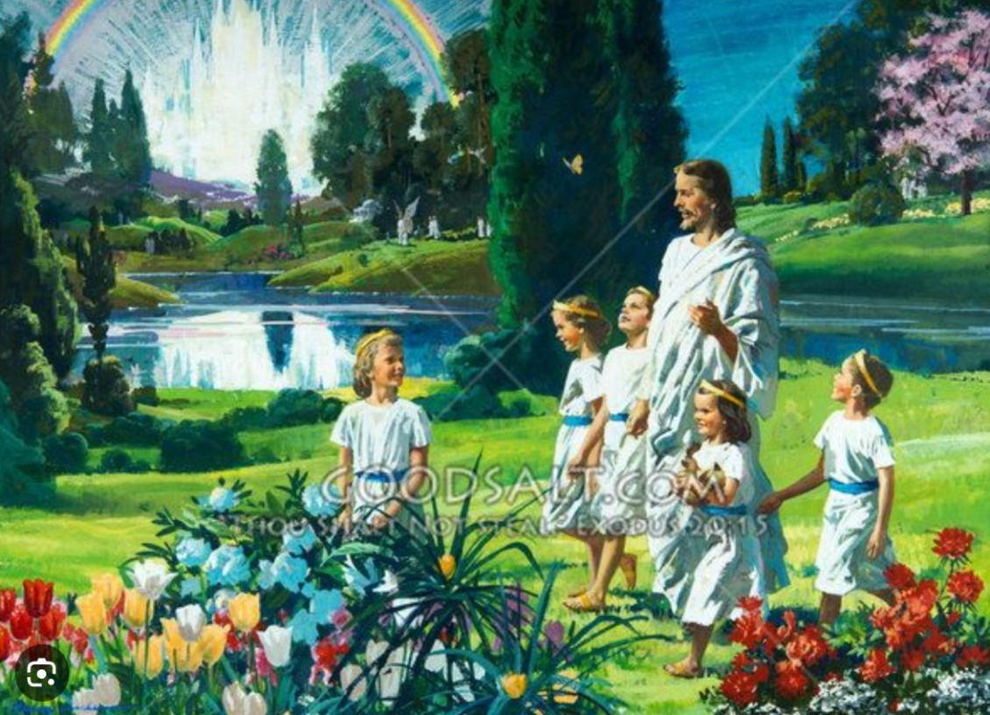
Zach 14:9
And the Lord shall be King over all the earth.
In that day it shall be—
“The Lord is one,”
And His name one.

