Slide 1
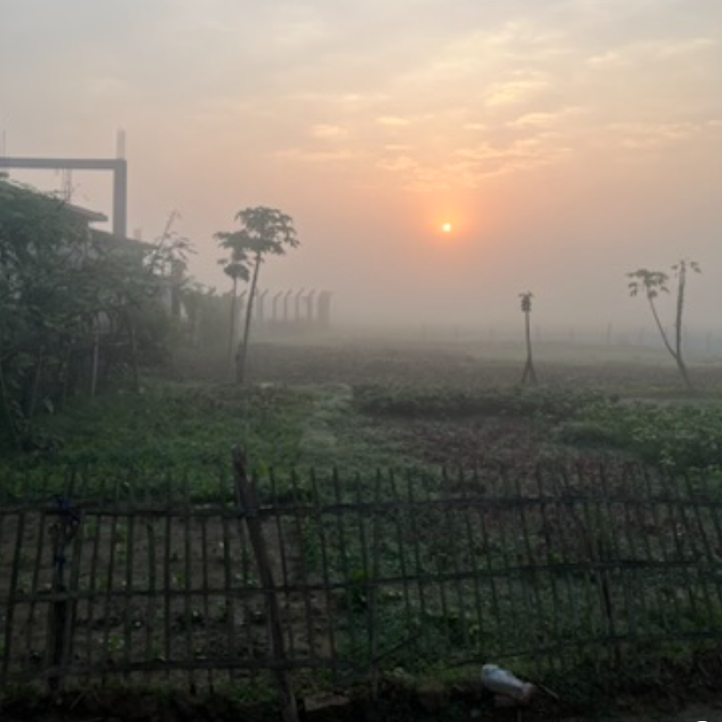
Bangla Hope
The Good News
Miracles are Every Where
Umapine SDA
August 12, 2023
Good News from God
June 3, 2023
Notes:
Last November I received a call from Dr Ken Rose, surgeon in Eastern OR. I had worked with him about eight years ago, helping his hospital start a medical group. … would you be interested in joining our Board for Bangla Hope, a Childrens home?
From this, we had three meetings about two hours in length over the next few months – Dr Rose and a few Board members and then Robyn Griffin, the on-site and US Coordinator.
I was getting up to speed and feeling confident…. At the end of the third meeting I asked Rob What Do You Need?… What he said astonished me “what do I need, what I need is to continually be closer to God, He is the only one I can count on and the only one that can bring solutions to us at Bangla Hope”!
He then reviewed the needs of that day:
two children without anyone to care for them were brought to us, but BH had no room.
Two individuals desperately needed surgery, but no place to take them.
I was greatly bothered by the difference between what I said… an innocent “What do you need” …. Just give me a problem and we will get right on it,…
Robs’ statement was about not depending on ourselves but going to the source, God the Father and His Son. It took me back in time… I was taken to Bible times, Rob’s comment realigned my thinking, my awareness of how I depend on my knowledge, experience and drive, to get things done … even though I pray, study and talk to others about God and ask to do God’s will… Our gifts come from God, He is our source for everything, I am a resource!
Every story or miracle in the Bible shows how they depended on God, He was their strength and things worked out … not immediately ie joseph or Daniel… but the stories where they did not depend on or follow God, never turned out very well. Moses striking the rock, Sampson cutting his hair, Jonah in the whale..
So here I was, preparing to bring my expertise to bear, but BH needed God! It was good, it WAS GOOD NEWS!
When I arrived at BH, what was needed were the talents and gifts from God! love, listening, kindness, joy, support, sharing, etc. It was crazy: In the US I can fix things… But in Bangladesh, I do not know how to build their way, I didn’t know how their electrical system or how their water pumps work, couldn’t help in the rice paddies … we do need God!
In the early 1880’s there was a fellow named George Muller, who lived in Europe, barely having enough to care for his own family, when he began seeing many children who had no food and no family. The Children became his lifetime work that became known as the Breakfast Club, caring for about 10,000 children. As he was nearing the end of his life, many were so worried about what would happen to the kids after he died, because there was no one to take over … his comment was “when I am gone, you will be surprised to find out that it was not me that took care of these children, it was God, I was merely His helper”!
Learning about the Waid’s, Robyn, the BH team, and of George Mueller … this was very important for me, God working with those that depended on Him, creating true miracles!

Slide 2
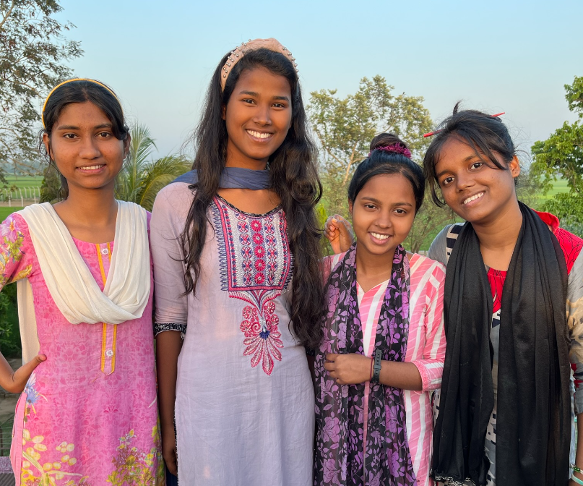
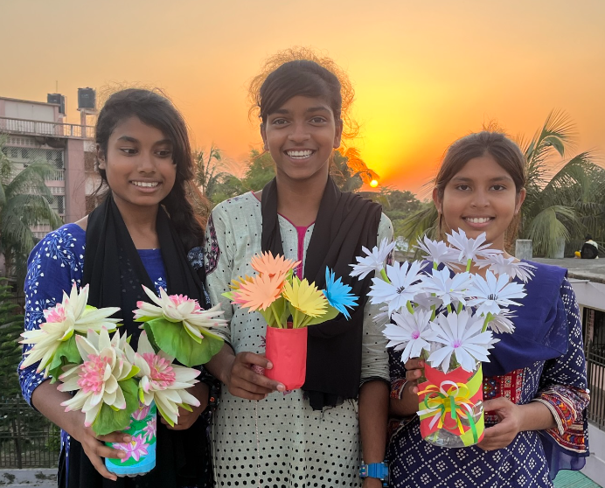
Notes:
The kids are so creative.

Slide 3
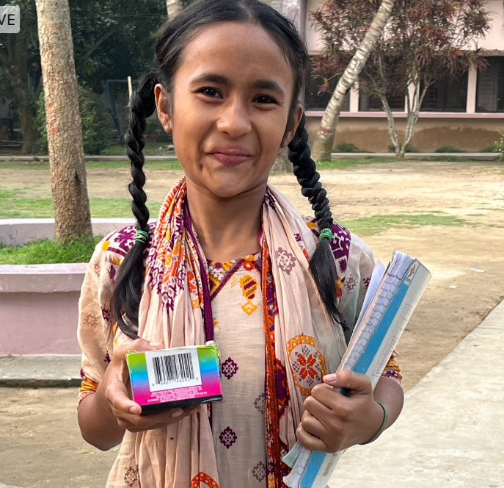
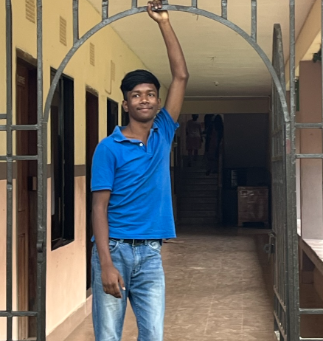

Slide 4
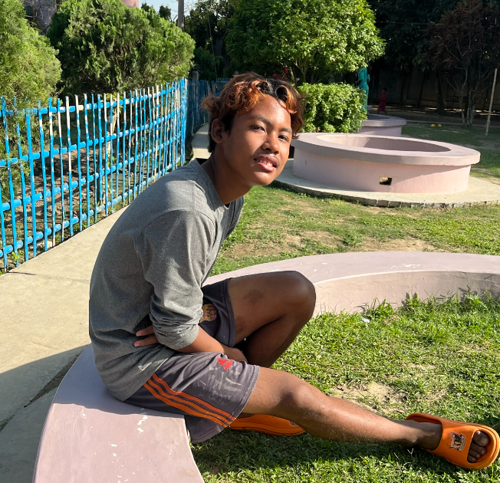
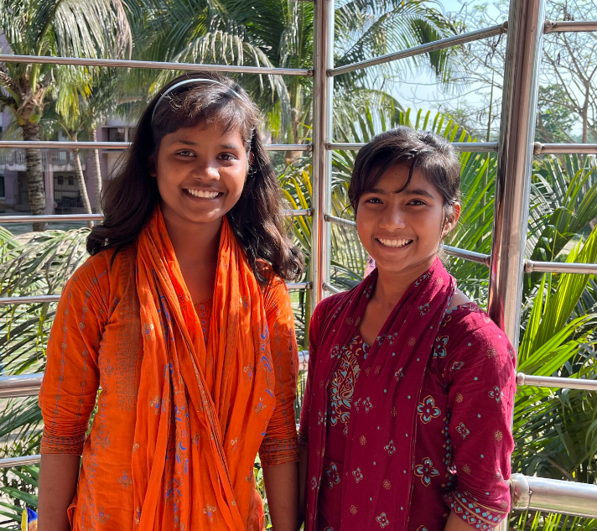
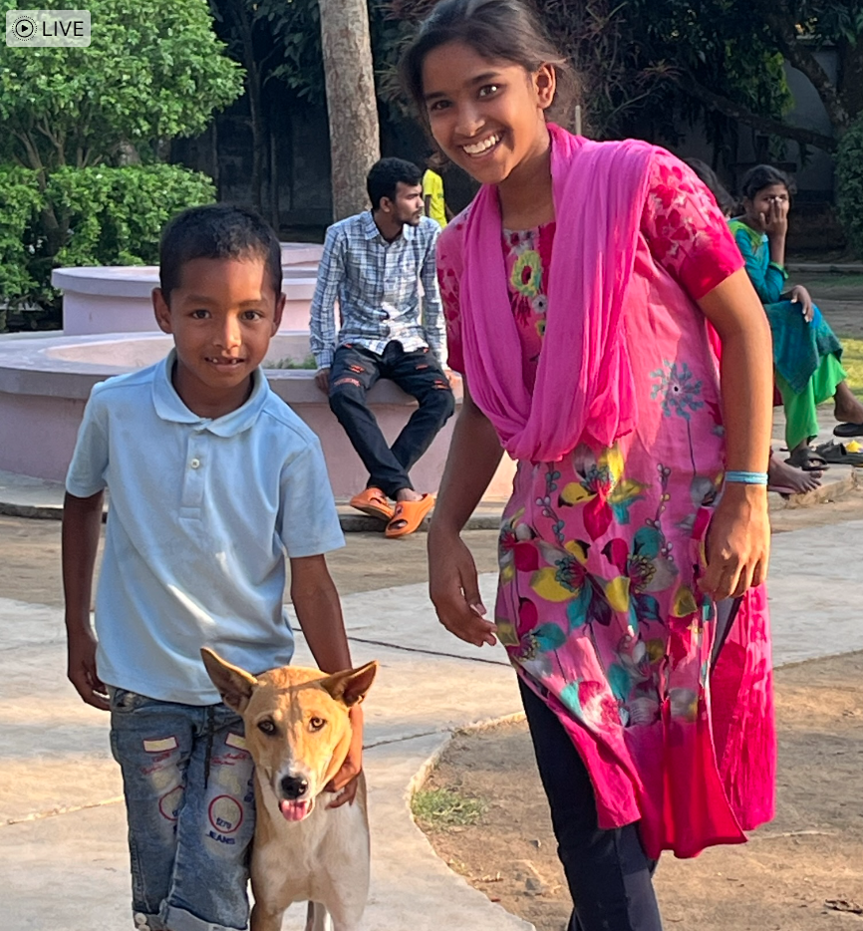
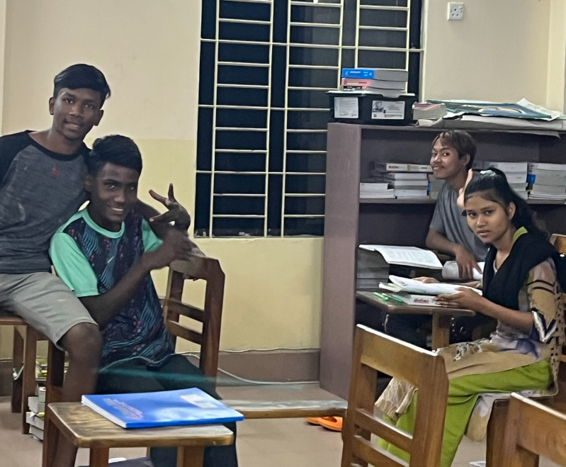
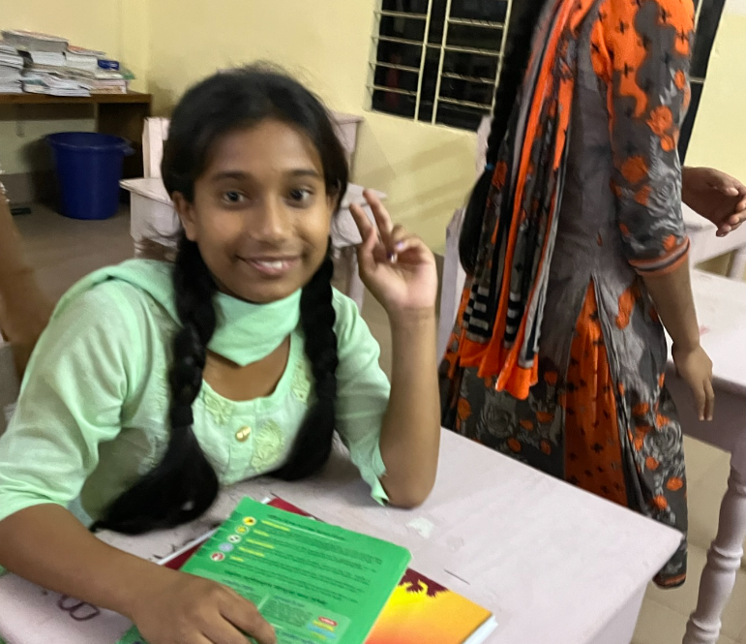

Slide 5
Umapine SDA … The Good News – God is Here with You
Prayer and Praise List is alive!
Baptisms
Prayer Meetings
Men’s Ministry John H
Women’s Ministry Kathy G
Elders are active w great sermons Dennis, Brigetta, Keith, Pam, Troy and Bill V
Reaching out Breakfasts, Movie night, Bread give away
Great flowers! Marsha, Carla and Dawn
Potluck / Fellowship lunches!
Bible Studies
Warm, friendly, kind, and loving church family that truly care about each other; followers of Christ
Notes:
Your church family has had a tragic event and that is the death of Lin Meyers. Several of your church members have been visiting with her every week for over the past two years, what a gift and blessing it was to share Jesus with her.

Slide 6
The Bible and Bible Stories … Bible Times
Old Testament
Adam and Eve, Noah, Moses, Ruth, Joseph, Daniel
New Testament
Mary, Jesus, Matthew, Peter, John, Paul
Today … we still live in Bible times, just like the people we have read about!
Jesus: By this all people will know that you are my disciples, if you have love for one another. John 13:35
Jesus: If anyone loves me, he will keep my word, and my Father will love him, and we will come to him and make our home with him. John 14:23
Notes:
The Bible. We have all read and heard the Bible stories; dynamic miracles, impossible outcomes.
Reading the Bible lets us see how God works, Bible study and Prayer lead us to God the Father and His Son Jesus Christ… but then God wants us to be a part of new stories, a part of new miracles, to see Him first hand.
This is eternal Life .. to know thee the only true God and Jesus Christ whom thou has sent.

Slide 7
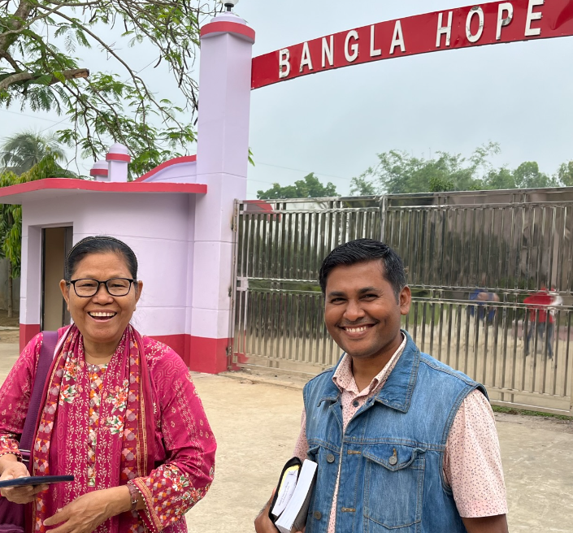
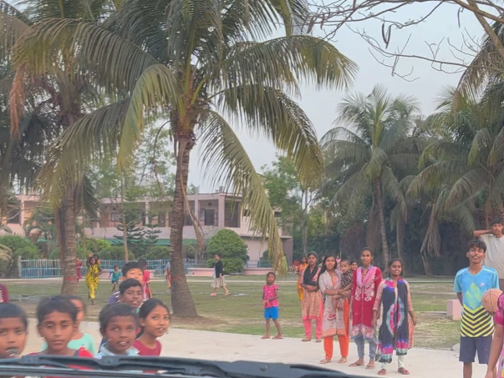
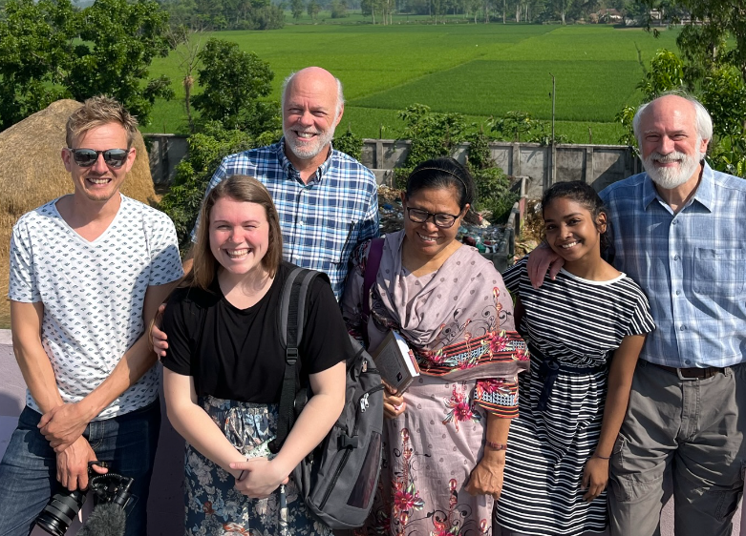
Our Greeting Team
Notes:
I was stunned by the joy, the intelligence, energy and kindness of the kids and staff. When I considered how their lives started but could clearly see their current trajectory to meeting their full purpose and potential in life, wow, 175 miracles talking to me each day.

Slide 8
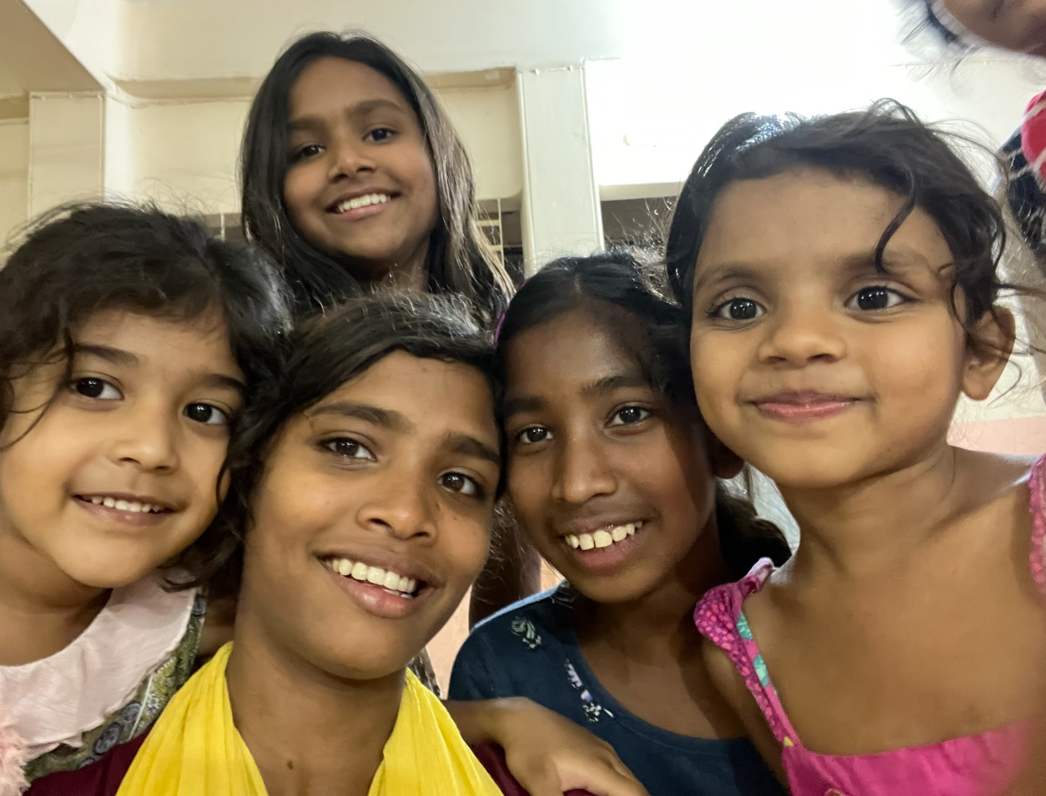
Bangla Hope Where it began
Beverly and David Waid Iron worker
Famine to Food surplus
The BH Kids show great promise for today and the future… Pastors, Dentists, Nurses, Physicians, Engineering
Bangladesh / Dhaka 23 M
Bangladesh is a beautiful country with great people
Massive poverty
Areas of country are improving
Notes:
I believe that you will see God in action at BH, that you will be proud to be a Christian, to be associated/know people that depend on God and then to see how God has and continues to bless them beyond imagination.
We do live in Bible times, they just haven’t been written about yet.
Bev and David Wade
Suddenly had three children then twenty
Didn’t have enough money for food
The local SDA church chipped in to support them, but this was difficult for them and temporary, but God had a plan... kind of like the story of Joseph, in a pit, slavery, jail, lost his family, … victory
So, what did BH do when money started to come in? Buy rice paddies outside of Dhaka…. 12 hour drive.
That turned out to be a great blessing as seen through the eyes of Covid … BH had extra food and began to provide the poor in their community with fifty pound bags of rice and potatoes every month
Built three wells for the local community
When the dark days comes in your life, God is preparing a way.
Watching and planning for the second coming of Christ is important, but before you get to that day, we have today …. Watching for the presence of Jesus today is essential, … His miracles are everywhere….. are we writing them down?! We should keep record. The outpouring of the Holy Spirit is on it’s way during the Latter Rain!

Slide 9
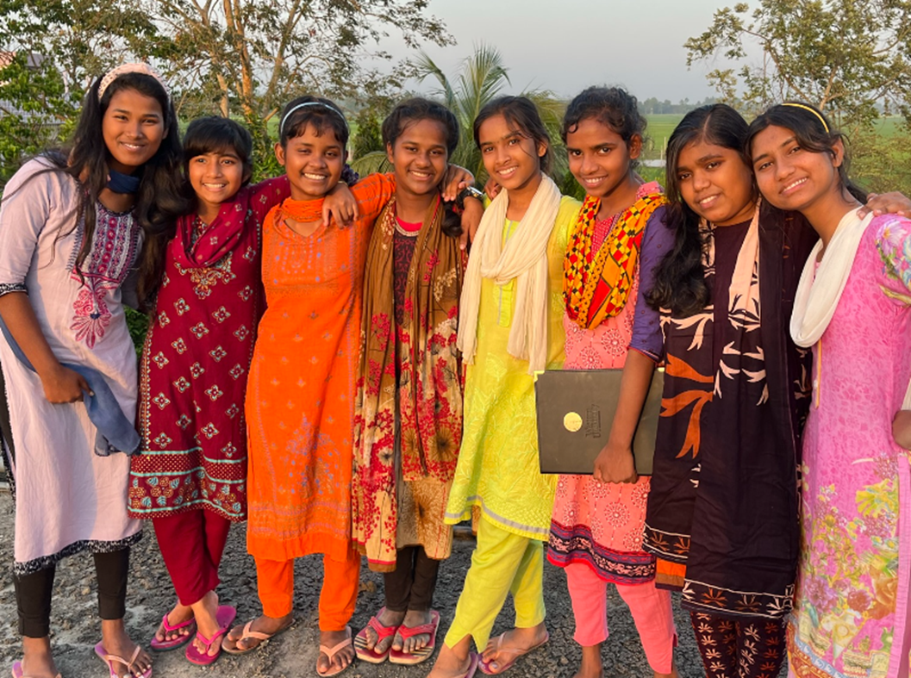
Bangla Hope Childrens Home
Significant Programs:
Creating a home, family, school, for children without families, and introducing them to Jesus - 175 kids
Eleven Village schools – 500 children
Sponsor poor children at SDA boarding schools – 1,000 kindergarten, elementary, high school and college BASC
Providing food for pregnant women …wic
BH: a people and place where they are getting to know and love Jesus; Miracles are every where.

Slide 10
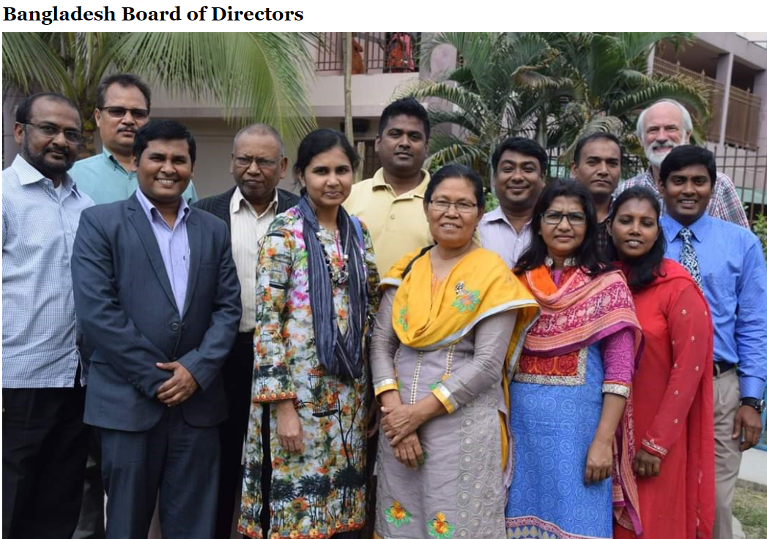
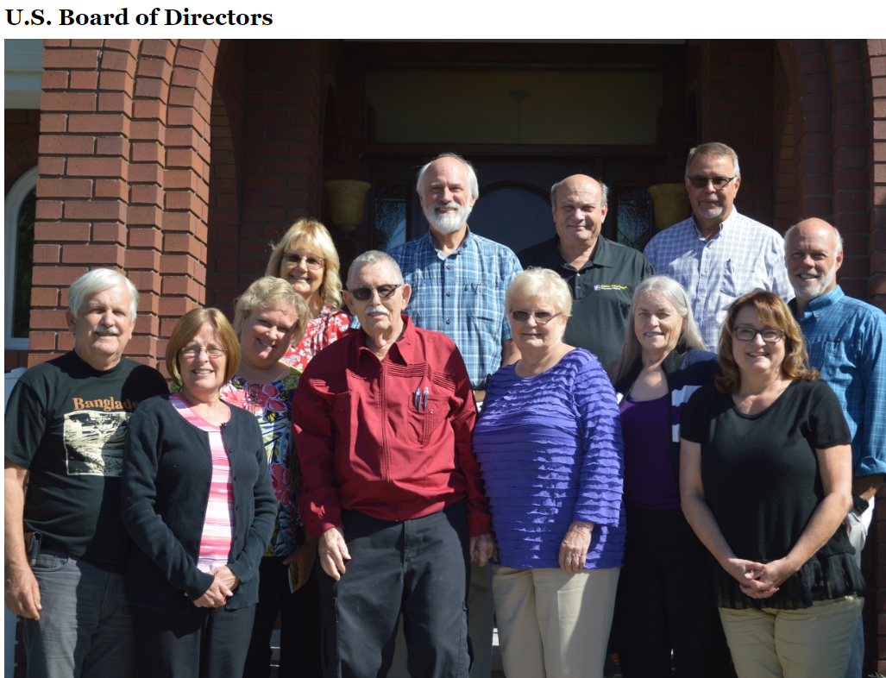
Notes:
Remember the Pastor that fed the children 25 years ago … his daughter is a dentist on the Board, Dr Lorna Biswas

Slide 11
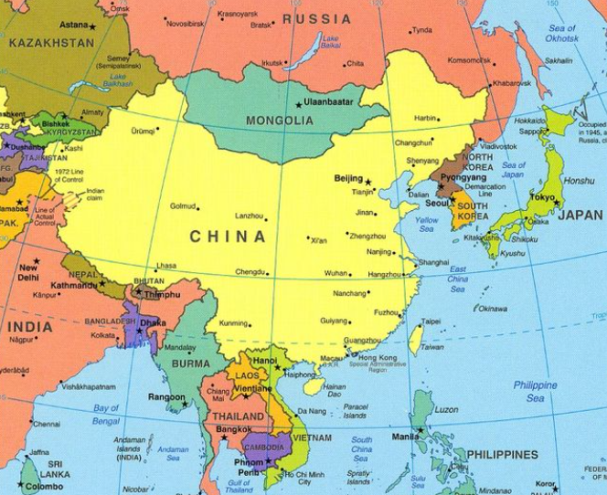
Bangla Hope
Good News from God
June 3, 2023

Slide 12
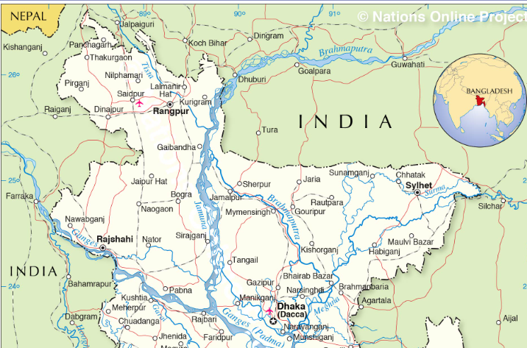
Bangla Hope
Good News from God
June 3, 2023
Village: Hazrapur, District: Jaipur Hat
Division: Dhaka Bangladesh

Slide 13
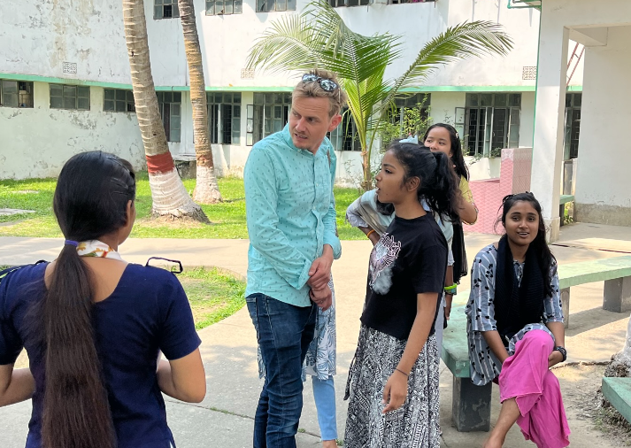
Bangladesh, a Refuge Humanitarian Crisis
The Rohingya people have been fleeing from Myanmar to Bangladesh since 2017
Kutupalong-Balukhali is the largest Expansion Site/Camp, with 635,000 Rohingya refugees.
SAMS – Maranatha Seminary / HS

Slide 14
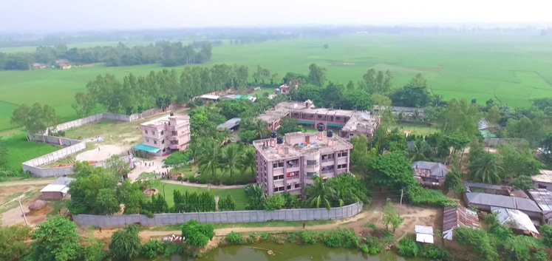
Notes:
This is what the campus looked like before January 5, 2021, Desperately needed to get these done, on Jan 5, 2021, BH decided to start the projects, they could not take in any more kids, they had to expand. They prayed for direction, they only wanted to be in alignment with God. On January 12, 2021, a check arrived from the US, it was written on Jan 5….
I asked if they ever brought in organizations to come in, pay for and build… NO
Our community needs work and our stores need to sell product … this builds relationships.
But, supporting missions is critical, Maranatha has done great work brining many high school kids on mission trips to build a school or church… this is a phenomenal experience.

Slide 15
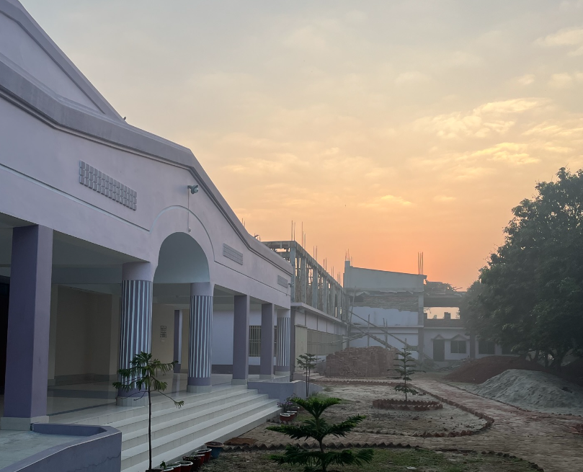
Notes:
If you can find your niche, something you believe in … there is a mission in great need, either near your home or far away in another land!

Slide 16
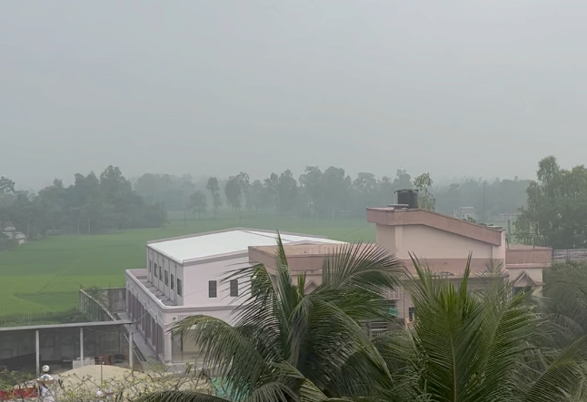
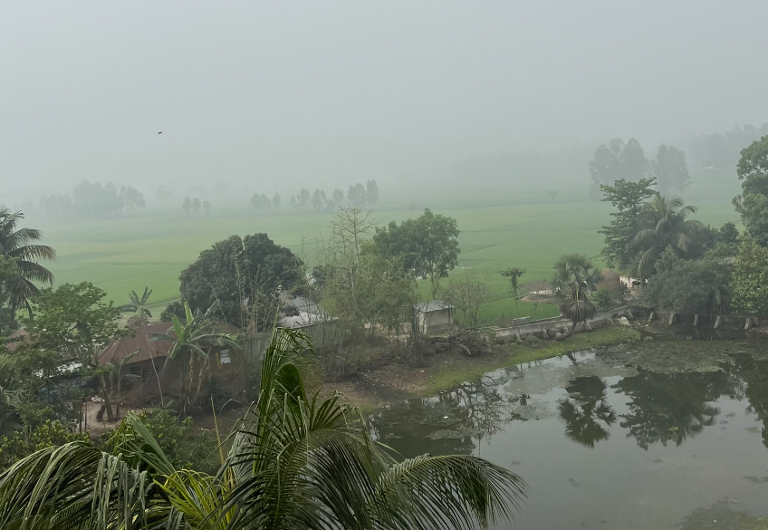
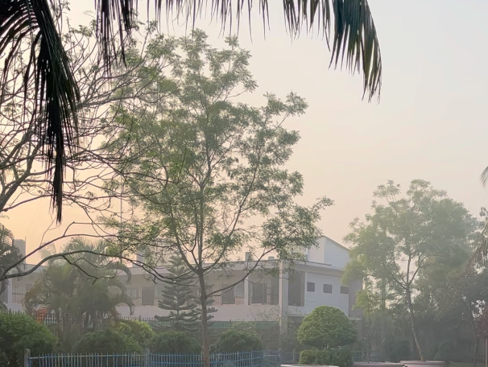
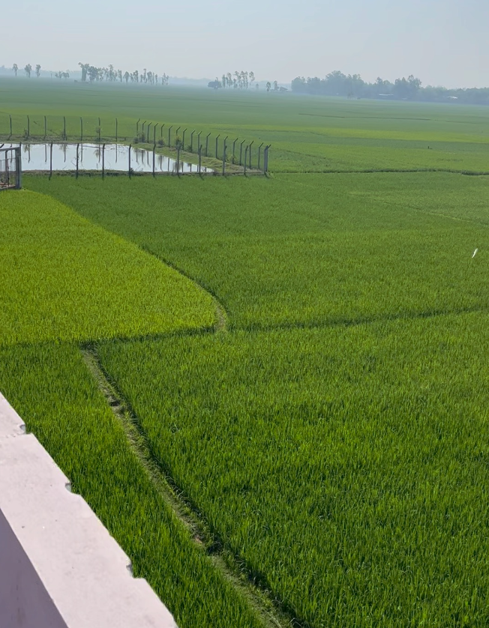

Slide 17
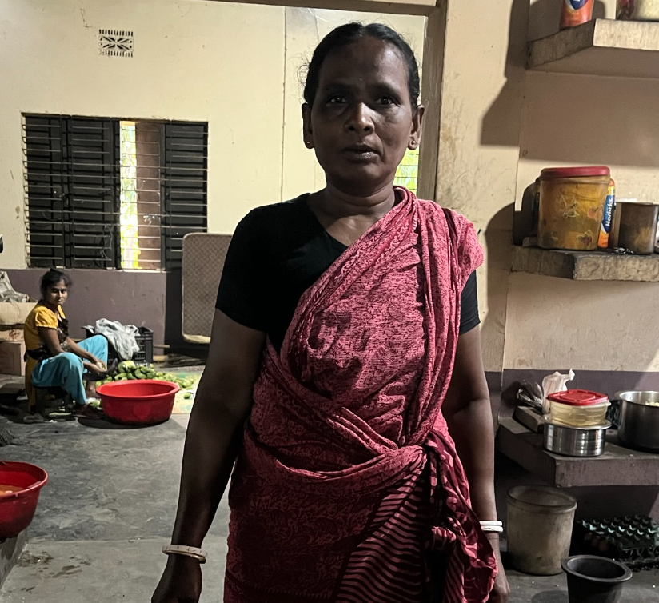
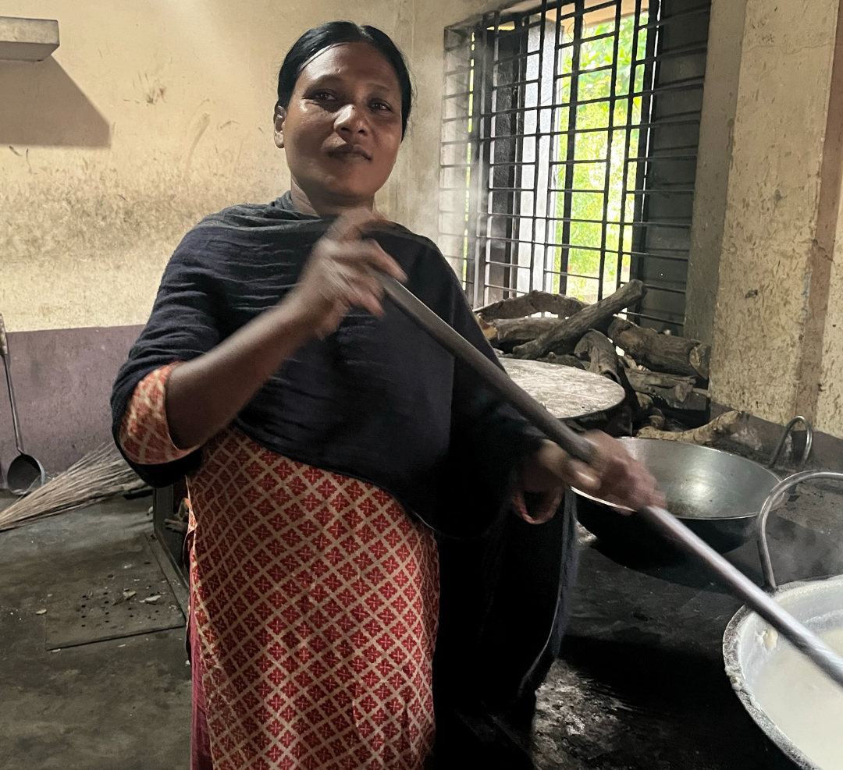
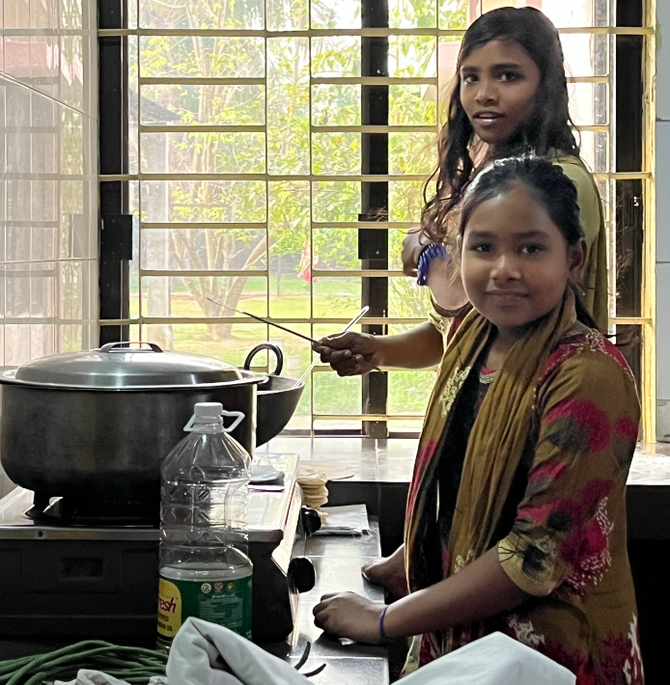
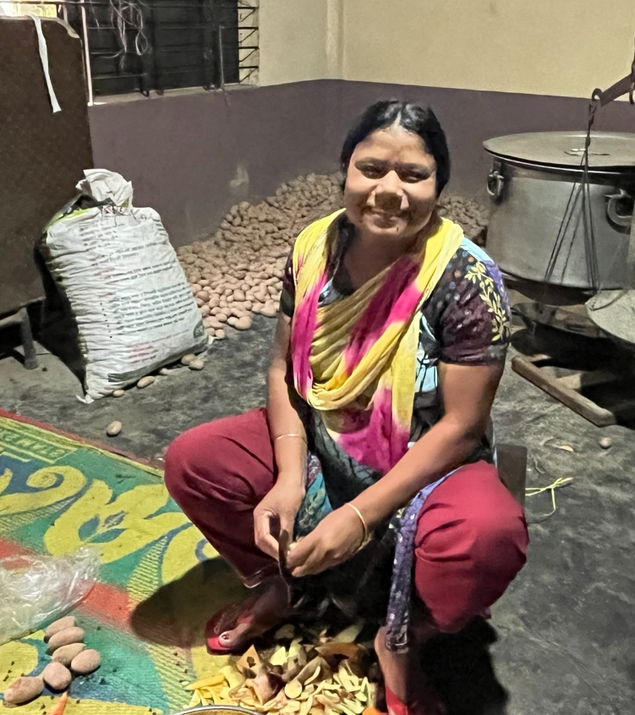
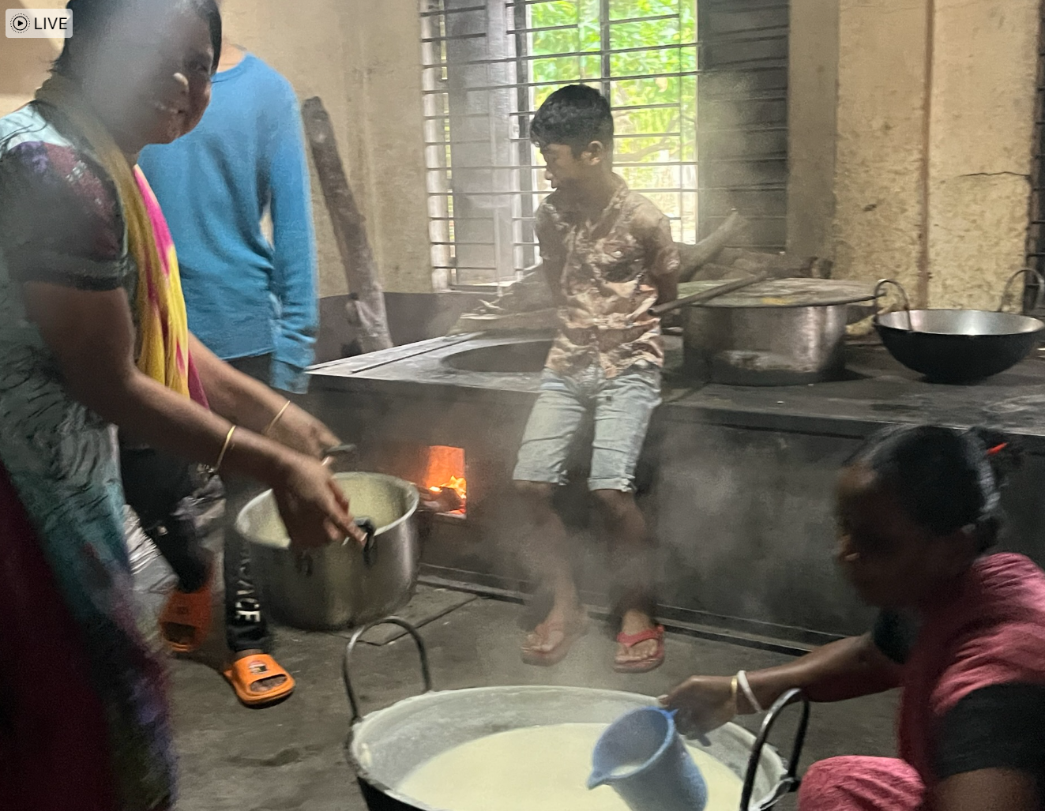
Notes:
17 Daily meals prepared … 600 on the main campus, with no refrigeration…. Five loaves and fishes. It does not seem possible to produce that much food with such a small team. The food is spectacular

Slide 18
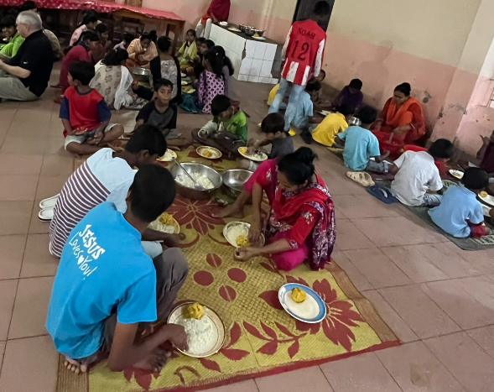
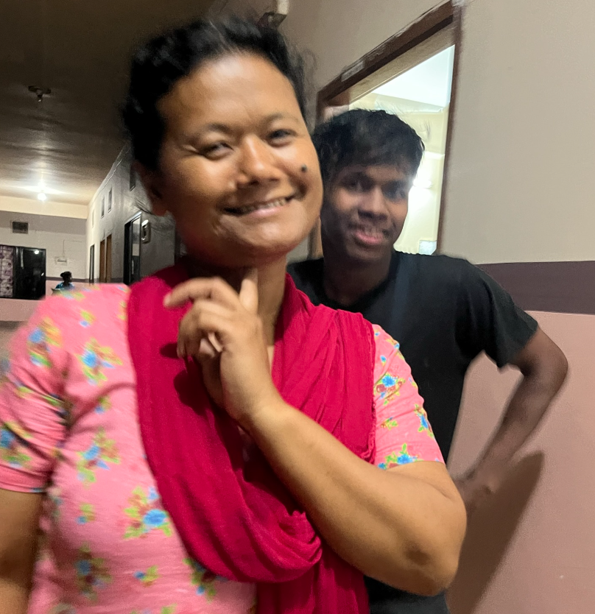
Notes:
Dinner … each group had someone serve up the food, but they could have all that they could eat or wanted. Again, the food was good.

Slide 20
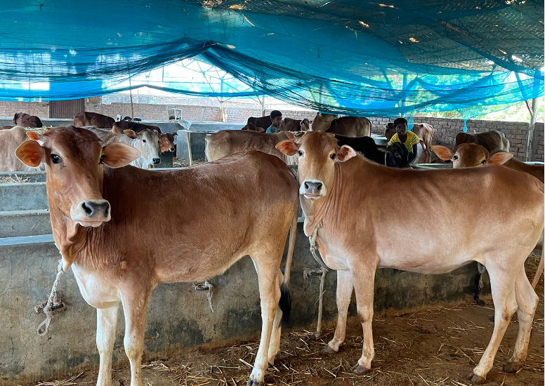
Reducing Risk / Independence
To ensure having enough food:
They bought Rice Paddies
Have a herd of cattle for milk, at 35 head
Sewing
Small general store
Next opportunity:
-cement/recycled plastic blocks?

Slide 21
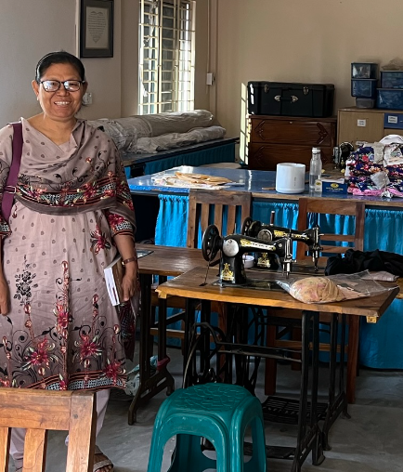
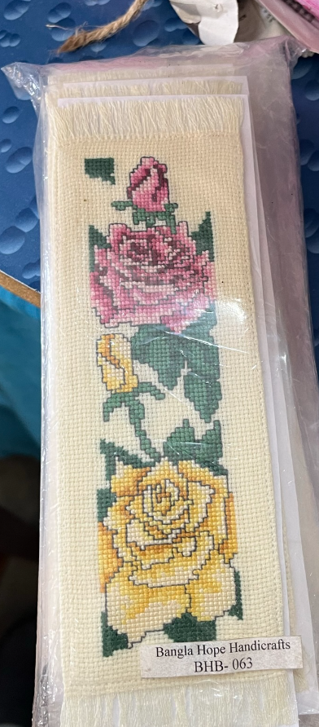
Notes:
New Police chief came to visit … what do you need? Sewing machines and truck … he brought them 10… they can make money here and save money by making clothing for the kids. Miracles from the Police Chief?!

Slide 22
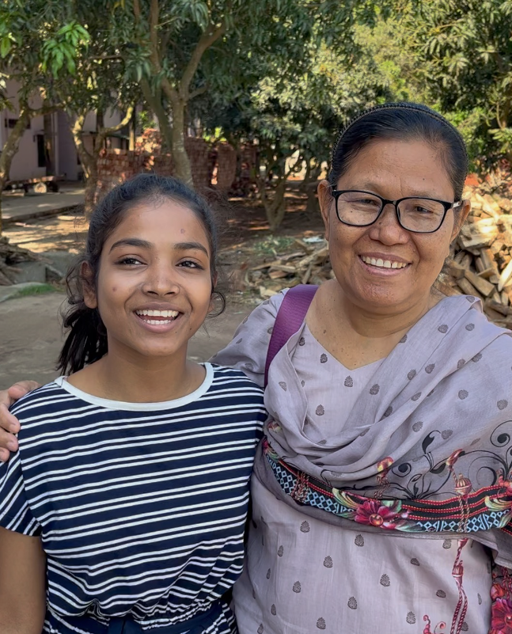
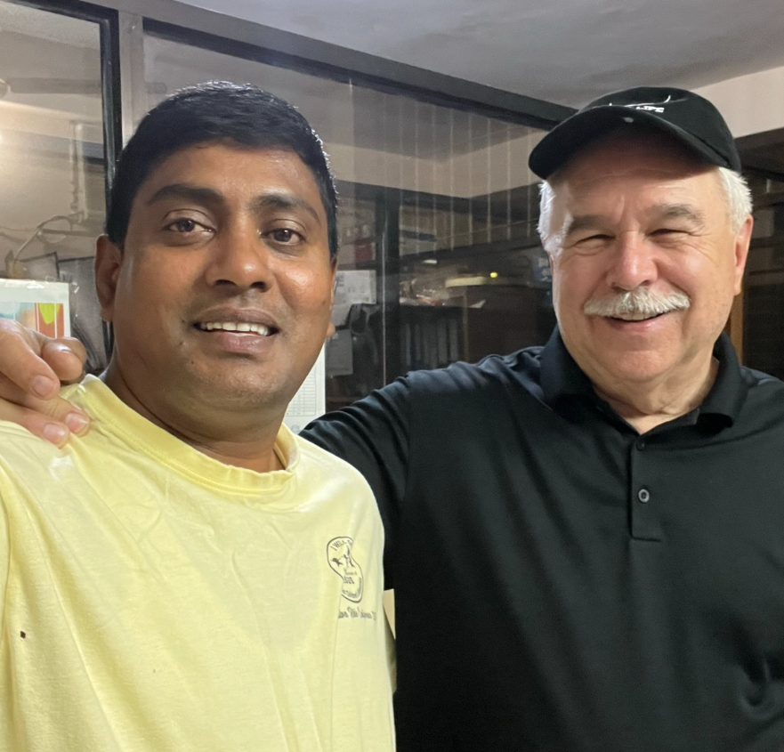

Slide 23
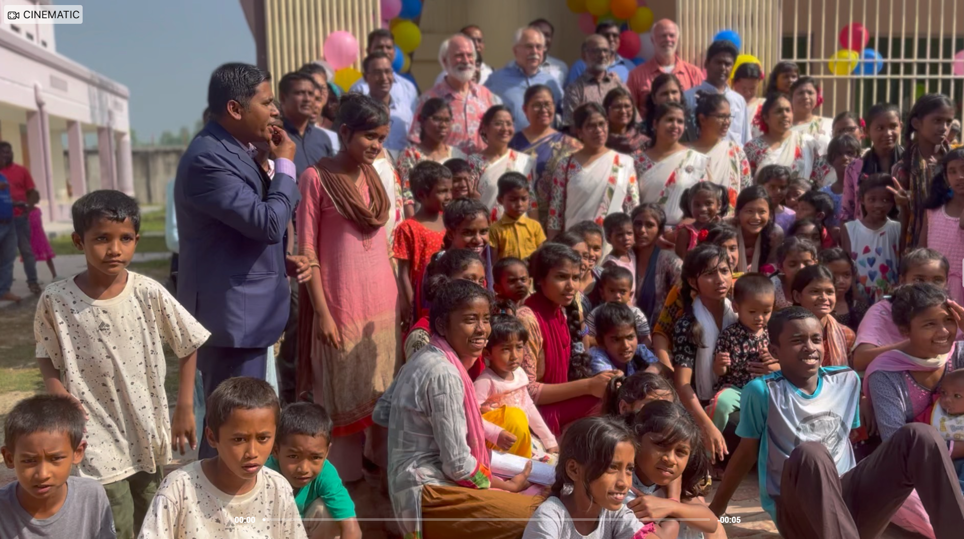
Notes:
23 Ribbon cutting for the new Girls Dorm, Litton presenting the story of getting this new building completed. BH needed more room to grow, as they planned for the Girls dorm, the money just showed up to pay for the whole project and more.

Slide 25
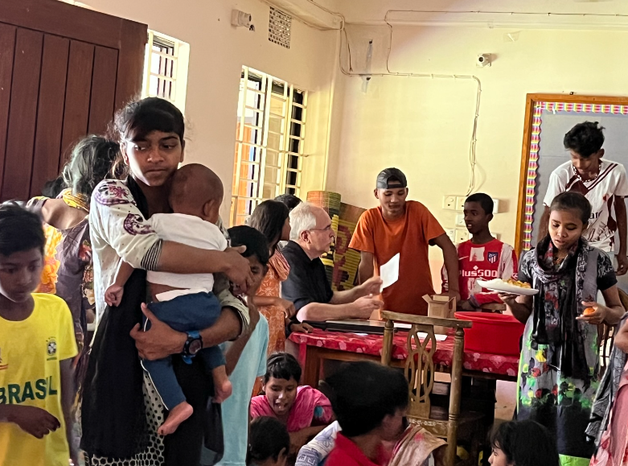
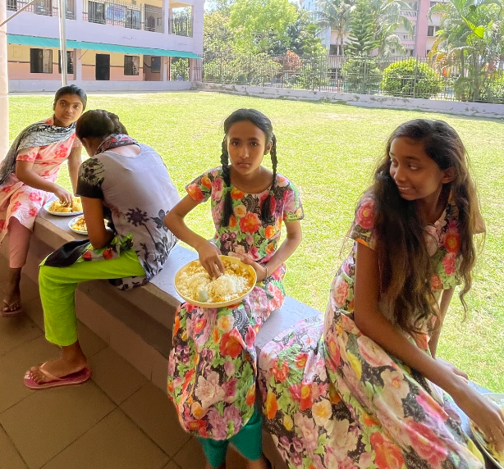
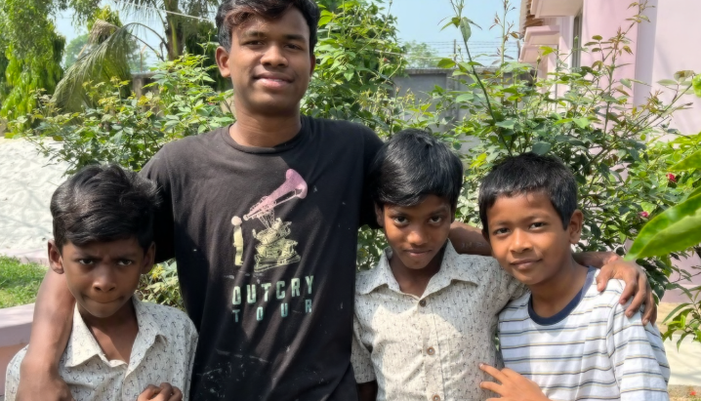
Notes:
25 I am working with a small group of kids to help me prepare for a worship talk. Because of the language issues for the younger kids, I was asking them what different words meant … My talk was going to be about Miracles.. because everything at BH showed clear evidence that God was there, leading and directing their path. When I asked what the word Miracle meant to them, Aaron, who is 9 yo said that “Bangla Hope is a Miracle”. My thoughts had already been that every child there was a miracle and the kids knew it. When you learned how their lives started and how they were doing now…. Every kid was indeed a miracle.
One of the 13 year old boys was telling me that we needed to improve our education and training re Commerce! What!?

Slide 26
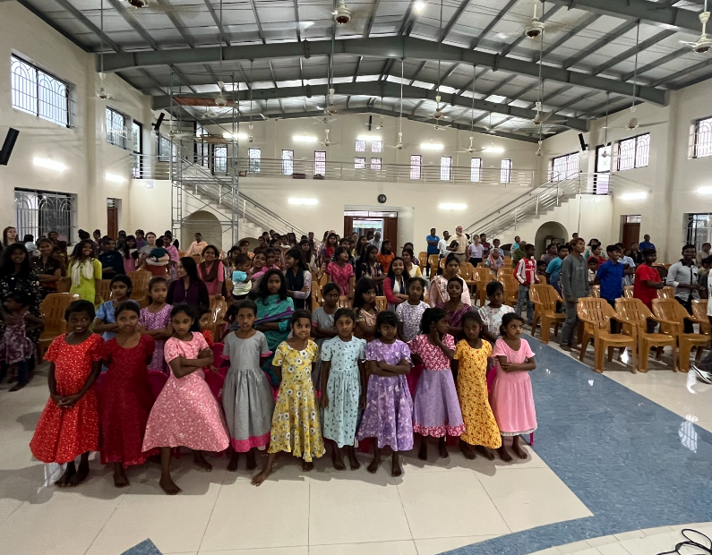
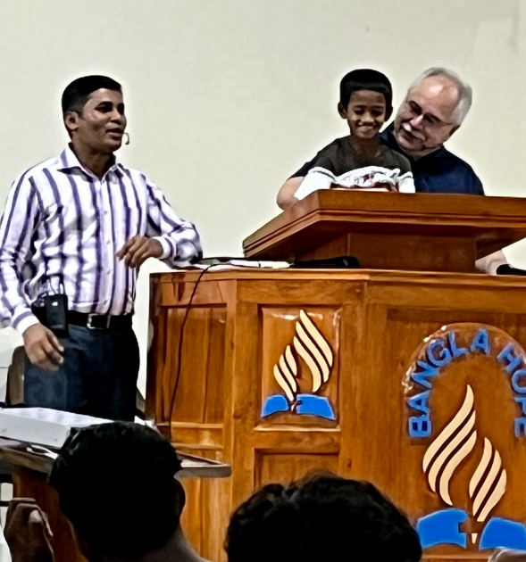
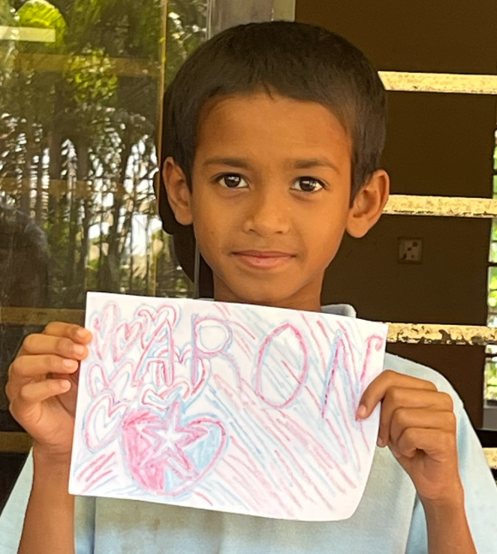
Notes:
26 Assembly hall for worship. Litton is going to interpret .. but Aaron did that for me, when I asked him in front of the group, What is a Miracle? He told everyone that BH was a miracle … he was very happy to talk!
The next day at our Board Meeting, Litton made “Banglahope is a Miracle” their Tag line.

Slide 27
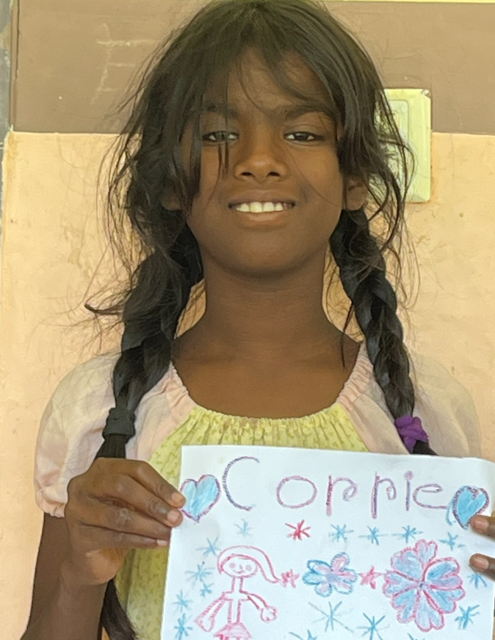
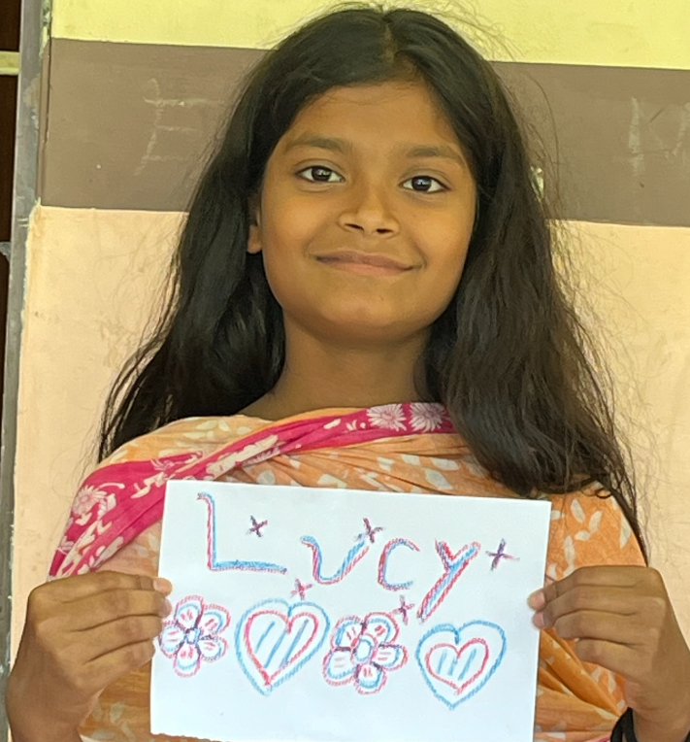
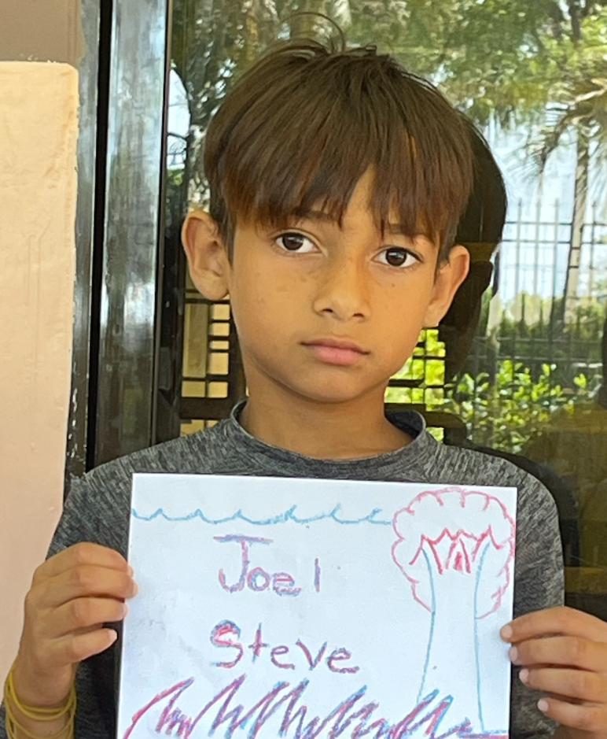
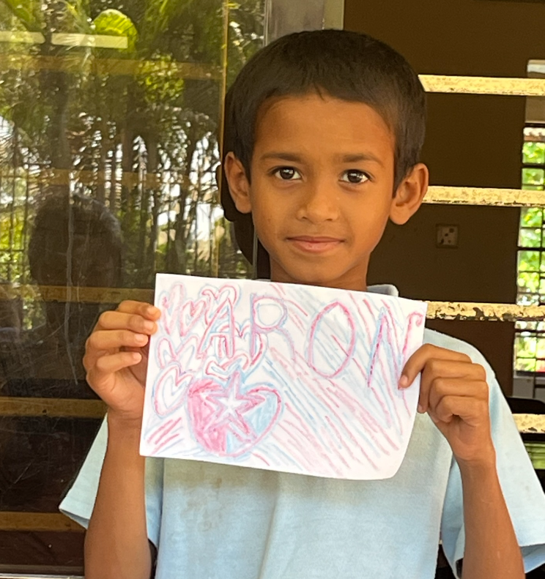
Notes:
The first day they were glad to tell you their name, by the second day they thought you should remember! The kids want you to know their names. … fyi, there is no way to learn 120 names, thank goodness the smallest kids didn’t care! So on the second day I had a great idea… I asked the kids to write their names on a piece of paper and then gave my phone to the kids to take the pics of all the other kids with their ‘name tag’!

Slide 28
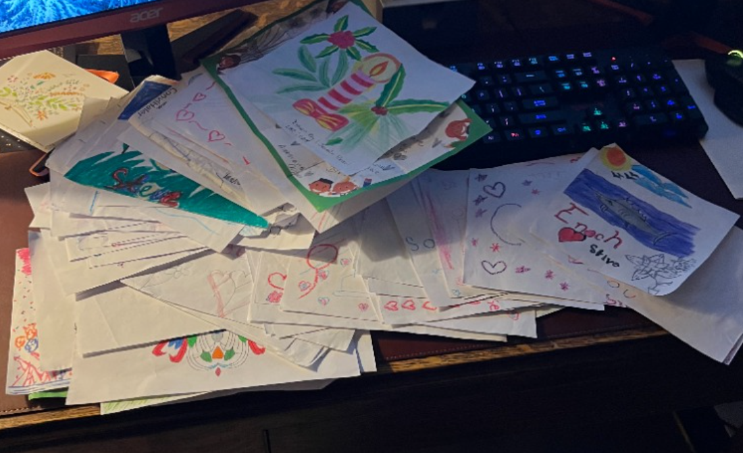
Notes:
28 Well, this was a good idea but by the third day there was no excuse if I didn’t get their name straight… so I would ask them to spell it and generally I could have it by the second or third letter…. Well let me tell you, this did not fly by the fourth day! It was great fun and the cards are really good, a lot of great messages.

Slide 29
Notes:
These girls took me up on the roof of the school, it’s where the older girls hang out after the day is ending. Gorgeous views … but it was quite emotional for me because you start thinking about how will these young women enter the real world outside of BH? How will they find a partner, how will they find good work, where will they live, where will they make money… they wanted to know what was wrong with me, but I couldn’t talk.
God tells us how to handle this kind of issue: Pray about everything, … Jesus said to ask anything in my name and I will do it. If you remember Elder Coon and the ABC’s of prayer
The kids are so creative. The paper flowers were outstanding, as was the sunset. They have so many skills: by the age of 12, most are fluent in Bengali and English, well educated, well spoken, knowledgeable of how to function in Bangladesh culture.
My thoughts were
They need camera’s, computers and a fund that starts on arrival ie $50/yr. so that they would have a good sum when they leave … but those are my thoughts… and remember God says that My thoughts are not your thoughts … so …. We will see!

Slide 30
Notes:
Dr Ken Rose in front of the new girls dorm.
The kids continually went in the nursery to get a small baby and carried them around, a real family.

Slide 31
Pathfinders Community Outreach
At 8 yo, Tisha met this girl and they became friends
At 12 yo the girl became very sick
BH took them to the Hospital and paid for the care
Joined the Village School
Today at 18 … nursing or police!
Notes:
31 The value of Pathfinders as seen through Tisha. When Tisha was about 8, one of the Pathfinders awards was to meet someone in the community as a friend and to invite them to BH for a meal. Tisha met a girl and they became good friends… about four years later, this girls mother told Tisha that her friend was very sick… Tisha went back and got Robyn and picked up the little girl and took her to the hospital, BH paid for the care.
After this, the girl started attending one of the Village schools and now would like to become a nurse but the family is pressing her to join the police force! Both are excellent choices that will give her the ability to earn a good living for the family.

Slide 32
Notes:
Shopping with Tisha: Tisha is now 18 and this past year has been attending school in India in preparation to go into Dentistry. So, while all the younger kids were in school, Tisha had time for us… she took us to a small village along with two young girls and one about 14… These kids have been taught the norms and mores of Bangladesh … she knew where to shop, she knew how to evaluate good material for the clothing and she knew how to negotiate with the vendors! Wow. It was quite a scene! She also kept us safe… she saw a situation developing and got us all inside of a store, amazing.

Slide 34
Village School
Notes:
Village School: When we arrived, they said to us, we did not know you were coming to visit us, we have nothing for you … Peter and Paul: silver and gold have I none, but… what I have I will give you, stand up and walk.
They brought cookies and drink, the younger kids drew us pictures and then the older kids came in and sang for us… it was amazing, it was worth far more than anything else they could have done.

Slide 35
Uncertainty can bring stress … but long before you had a need, God is creating the solution, we pray for this moment, this hour, but God is also looking out for us weeks and years ahead of time.
Notes:
Always looking out for the younger kids

Slide 36
Notes:
36 What their daily schedule looked like:
6:30a worship, 7a Breakfast, 8a school till 1p, 1p lunch, 2p work time, 4p play time, dinner at 5:30p, worship at 6:30p and study hall at 7P and in bed by 9p

Slide 37
BH Family
Caring for the little ones is a really important role that most of the older (8+) kids take on
Don’t get weary in well doing.
One of the girls asked if I was going to come back? I said that I would like to … “Maybe is not an option, it is yes or no!”

Slide 38
The Kids are Busy

Slide 39
Community Outreach
Notes:
Brick home for woman in desperate need. Boats for the monsoon season.

Slide 40
Community Outreach

Slide 41
Community Outreach

Slide 42
Sunity was the 3rd Child, had Cerebral Palsy – just died a few weeks ago.
A few of the Kids at SAMS getting ready for College – Nursing and Dentistry in the Philipines

Slide 43
Kids heading out to prepare for Advanced Degrees
Notes:
Heading to SAMS!

Slide 44
Thoughts Gained from Bangla Hope:
It is important/essential for us to read and study the Bible…. The Bible teaches us and leads us to God the Father and His Son…eternal life. What I saw at Bangla Hope was God in action, Bible stories are being written as Bangla Hope continually experiences the blessings and presence of God.
BH has kept God First in their lives …. They did not have just enough, they had more than enough, to feed the starving community.
Bad breaks are not the end of our story, God knows our situation, we are not alone .. God is here today; God is with you at home. God has our destiny in his hands, there is something very significant for each of us yet to accomplish.

Slide 45
Banglahope.org
Honor God and He will honor you; Invite Him into your life, and you will receive blessings pressed down, shaken together and overflowing.
Our past does not have a role in God’s calling for us …Through Christ we can become what we were created to be.
God's blessings will leave you awe struck; unexpected doors open, He is supernatural, unlimited ... God has ways that we have never thought of nor imagined, to accomplish His work.
Christ in you, the hope of Glory … He is in Bangladesh with the people of Bangla Hope and here today with each of you.

Slide 46
Thank you so much for being here!

Slide 47
Bangla Hope
MISSION STATEMENT: To provide for the physical, mental, emotional and spiritual well-being of vulnerable children, youth and women in Bangladesh.
VISION STATEMENT:
To prepare those we serve for a successful life now and for the future.

Slide 48
Sabbath School Class

